Slide 1
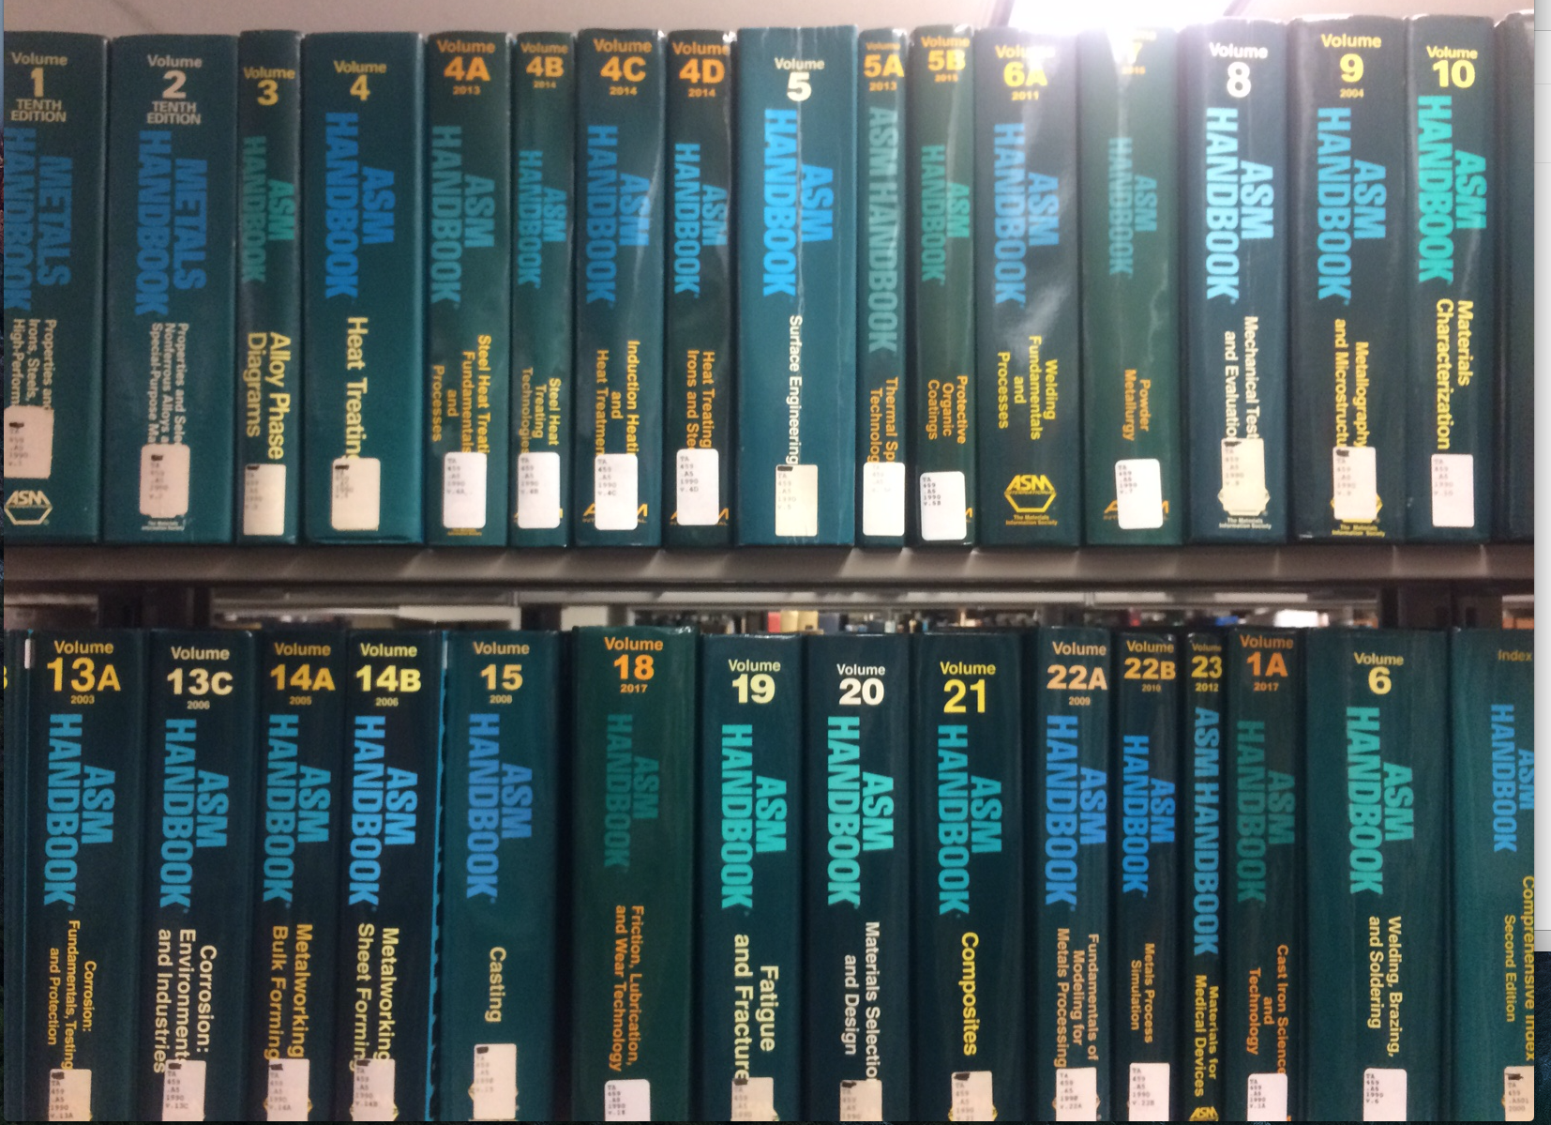
Metals Handbooks in Valley Library
* Call number TA459 near South wall of first floor.
Because I get questions that are best answered in the tried and true ASM handbooks.
Pete Eschbach

Slide 2
Also the desktop Handbook

Slide 3
From the desktop reference, a recipe for Austenitic and Ferritic Steel etching.
Oxalic Acid etch
Nital etch.
Also see Pace technologies website:
http://www.metallographic.com/Etchants/Etchants.htm

