Slide 1
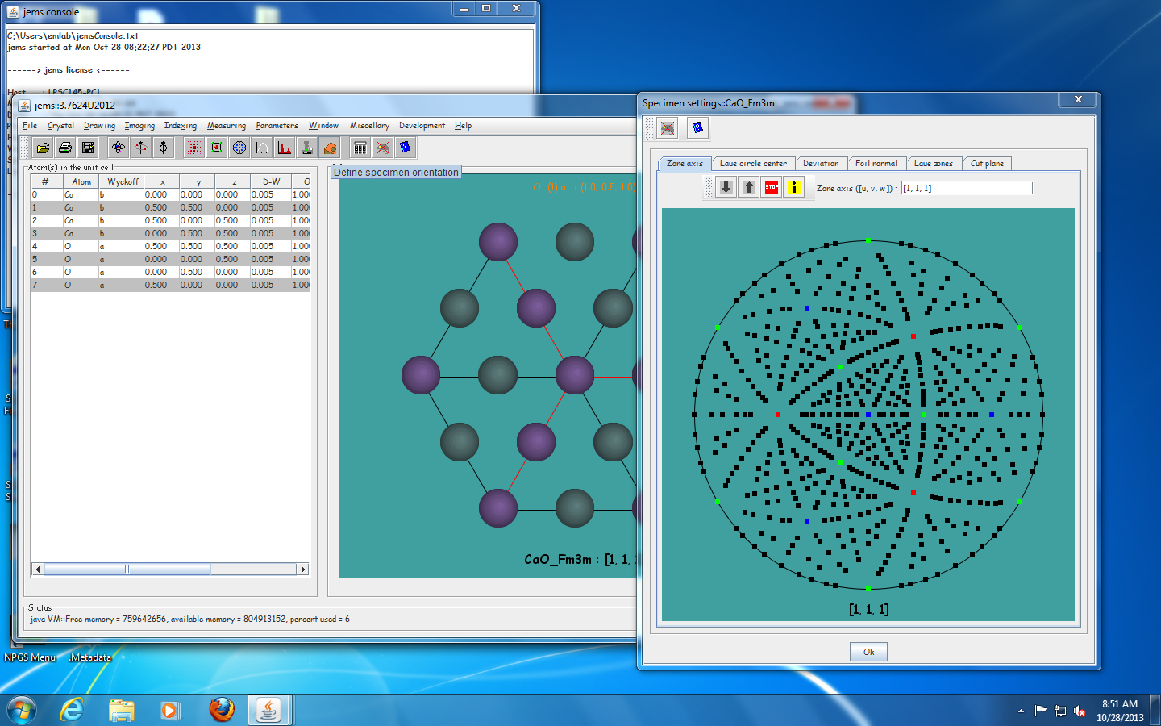
To change zone axis use the “Define Specimen Orientation tool” Circled below

Slide 2
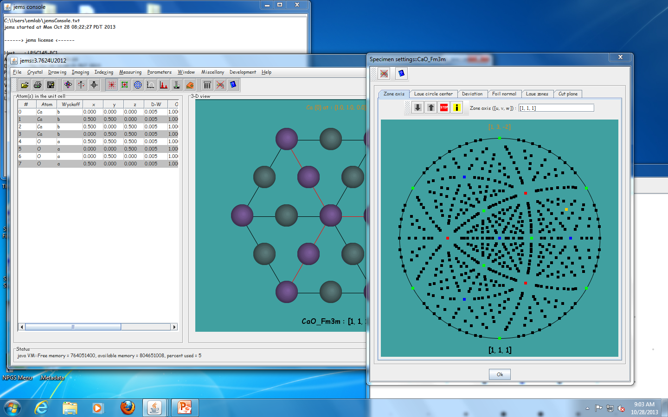
Click draw diffraction pattern tool

Slide 3
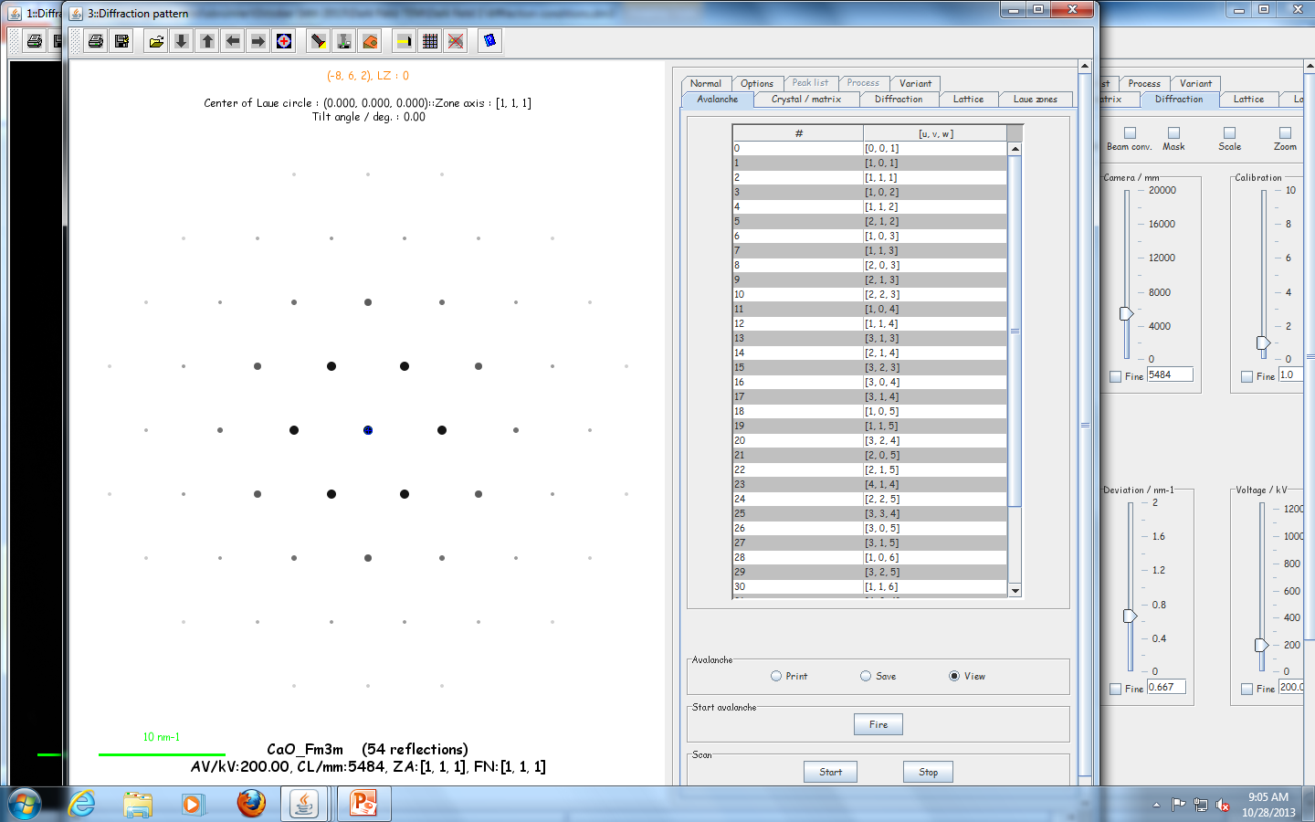
Diffraction Pattern is now created

Slide 4
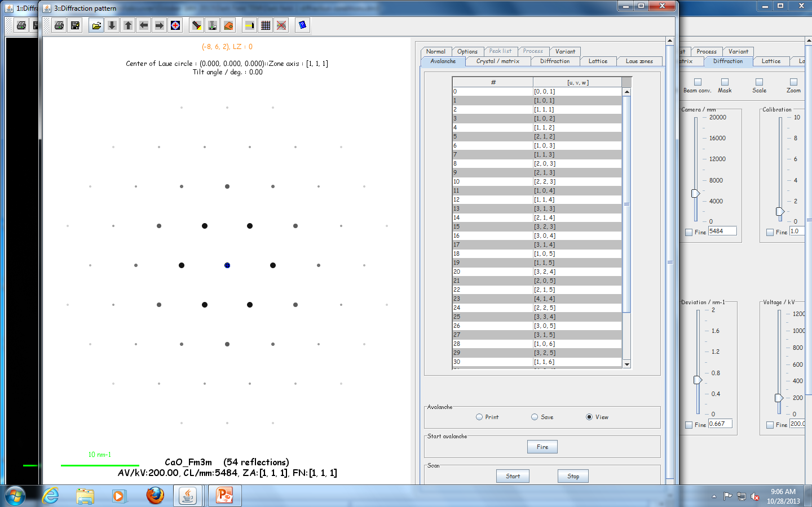
Now import experimental Data

Slide 5
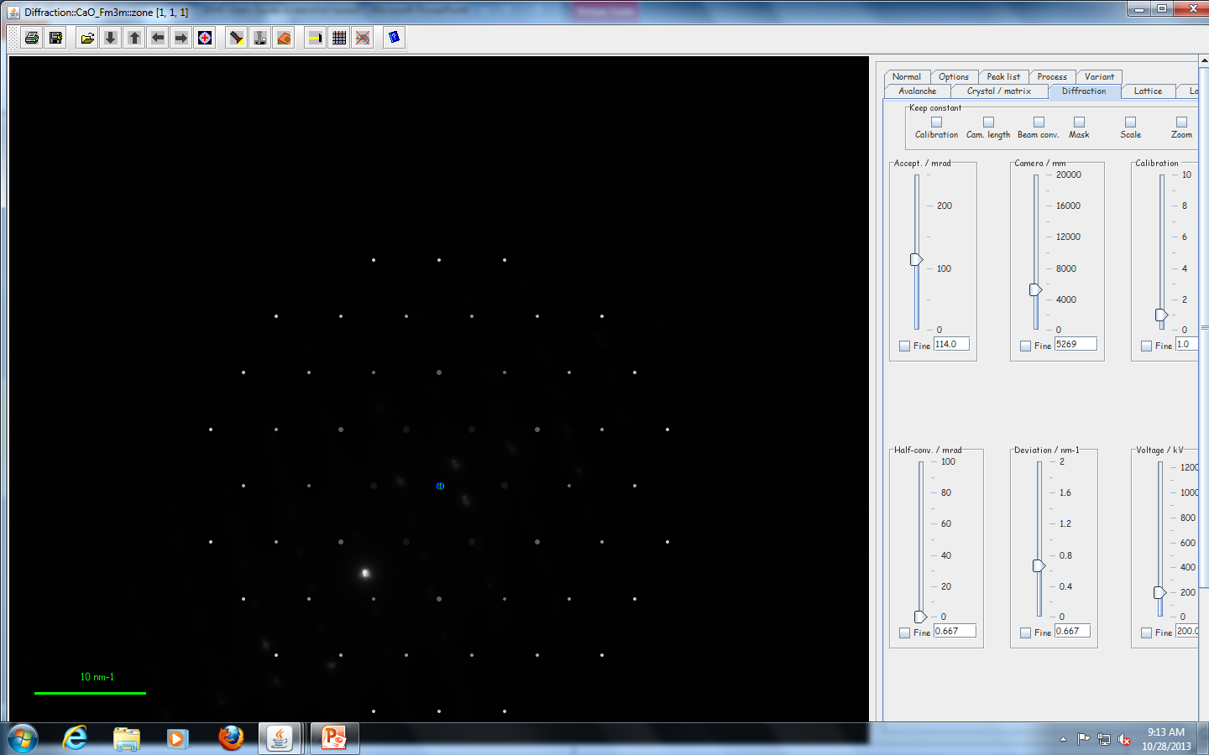
Now that experimental pattern is in, move the pattern to overlap with peaks by adjusting camera length and centering.

Slide 6
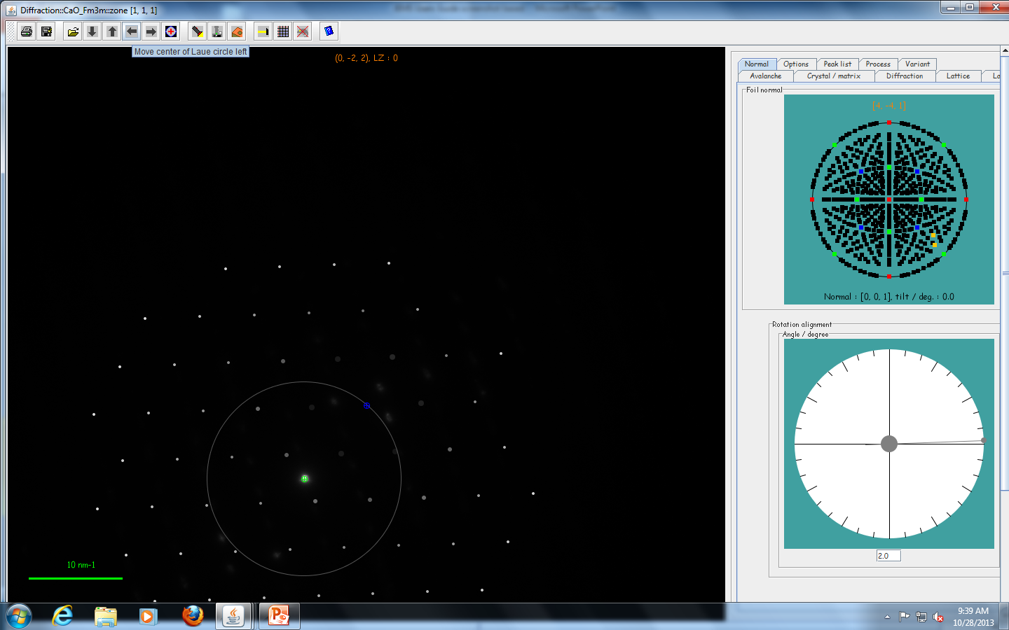
How to move pattern center
Click arrows to move pattern left and right, up and down.
Change angles of zone axis in Normal tab

