Slide 1
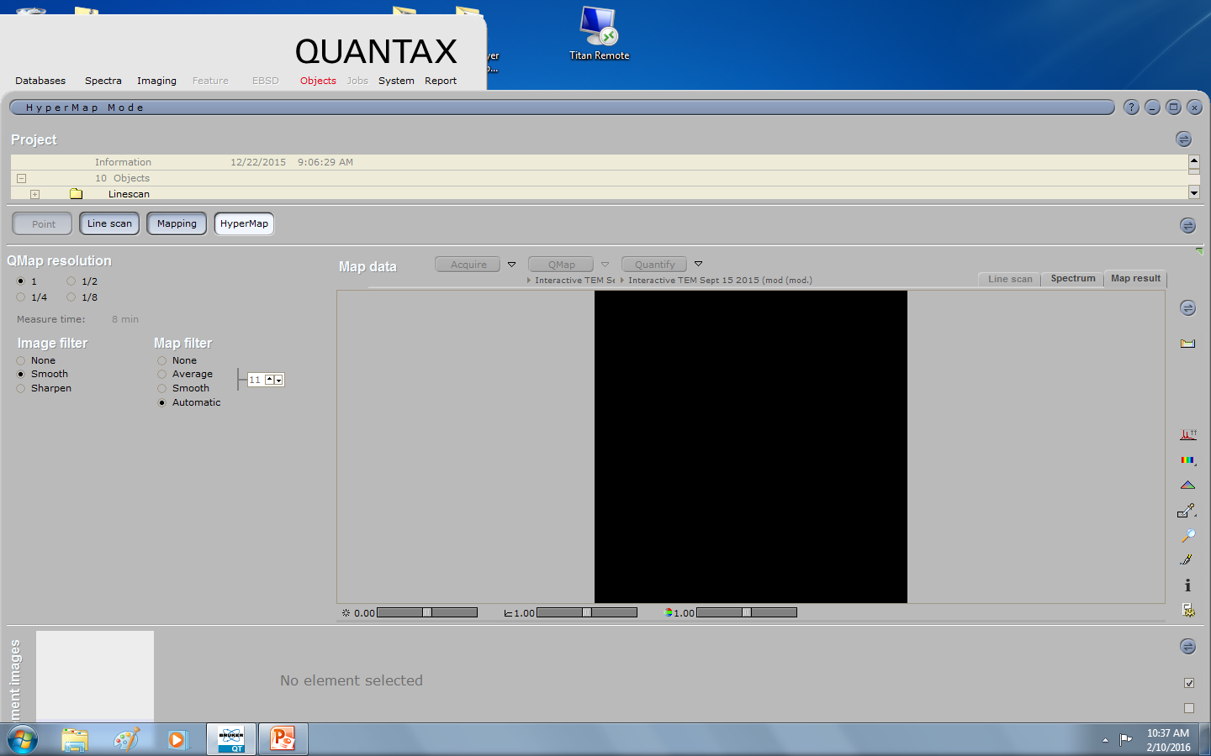
To Open BCF (Your hypermap)

Slide 2
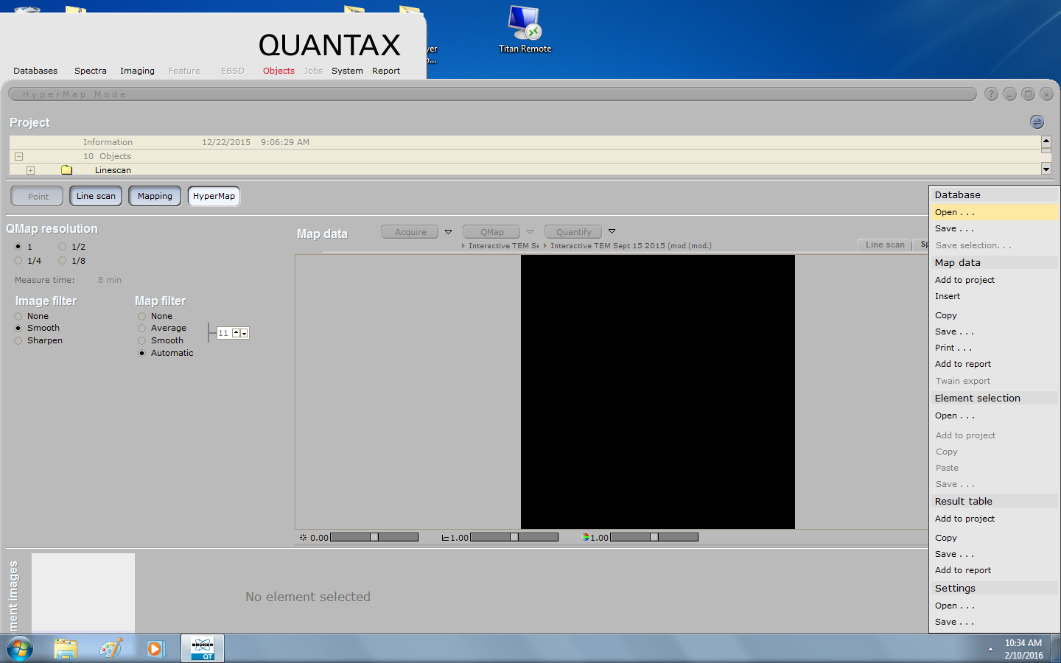
Now open

Slide 3
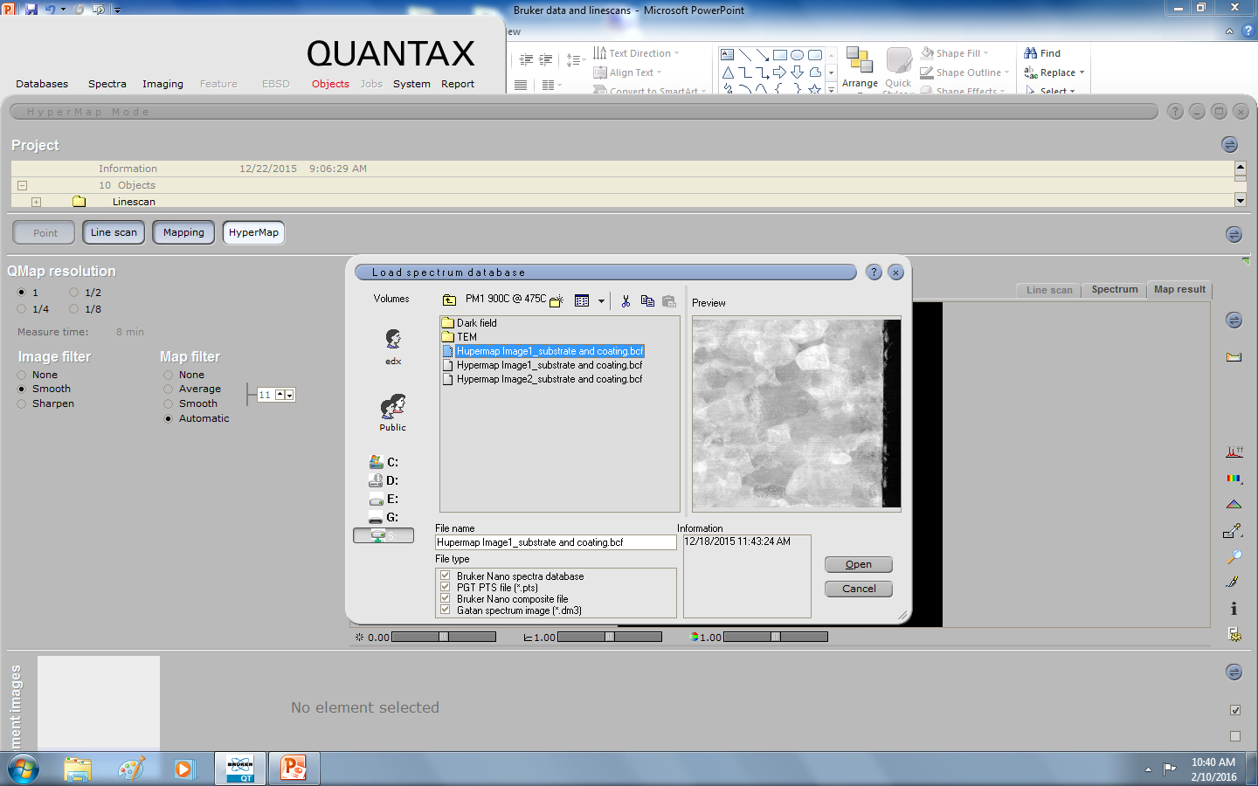
Select your .BCF from NAS drive or the EDX computer, I have copies in both places for you!

Slide 4
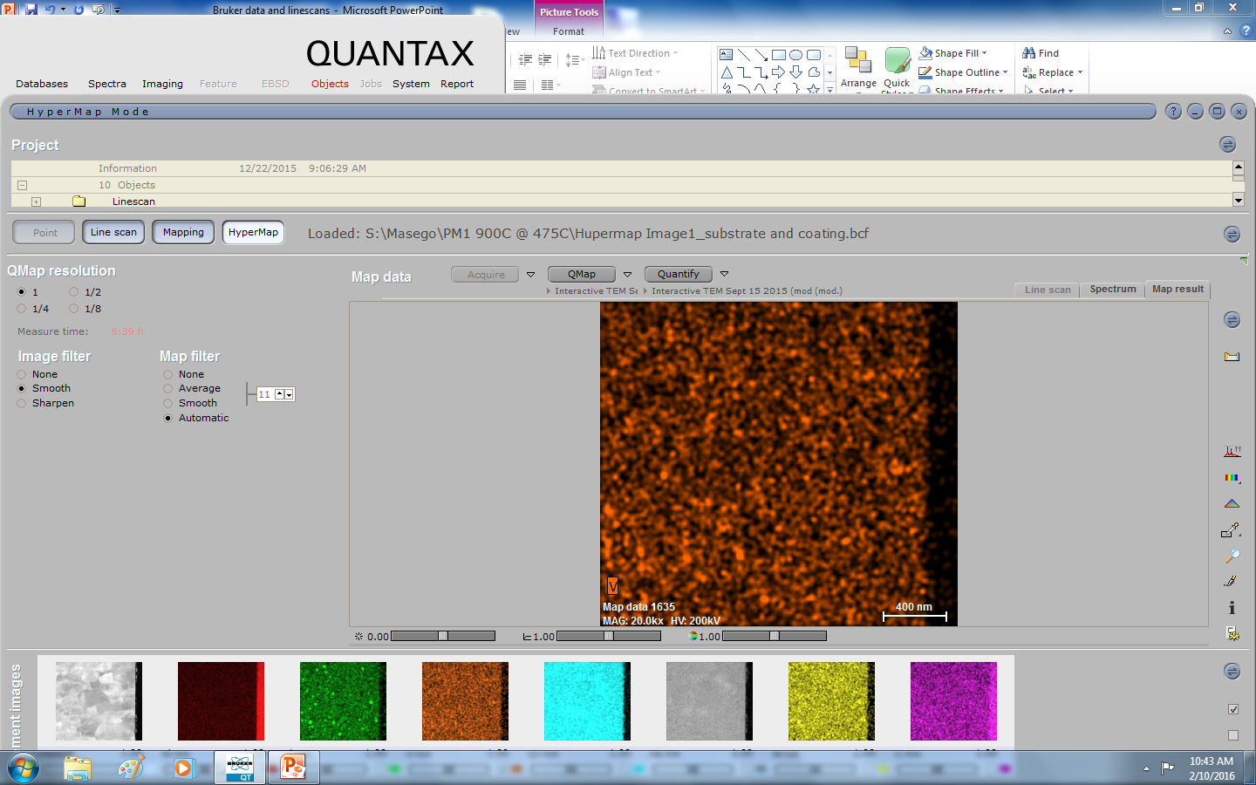
Now your BCF is open, you can create Quant maps and or LineScans

Slide 5

To quantitate, select method and hit quant map, QMap

Slide 6
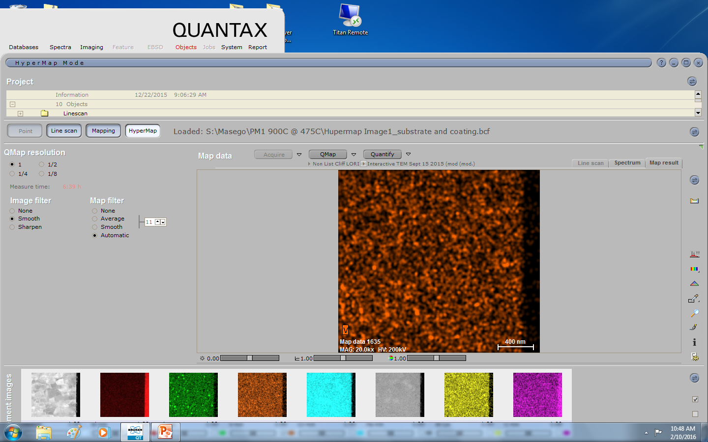
Select method part I
Click here to select method

Slide 7
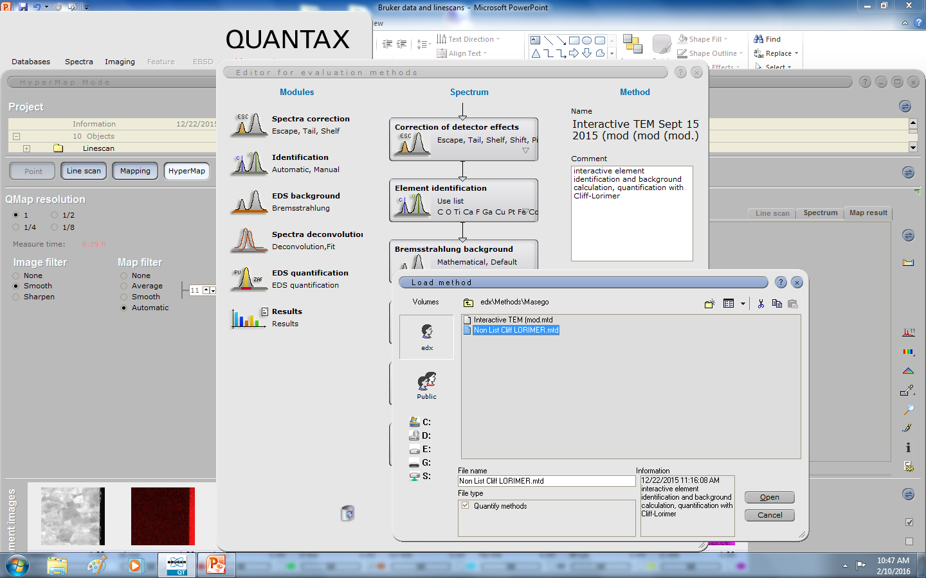
Selecting Method
Select from edx\Methods\Masego

Slide 8
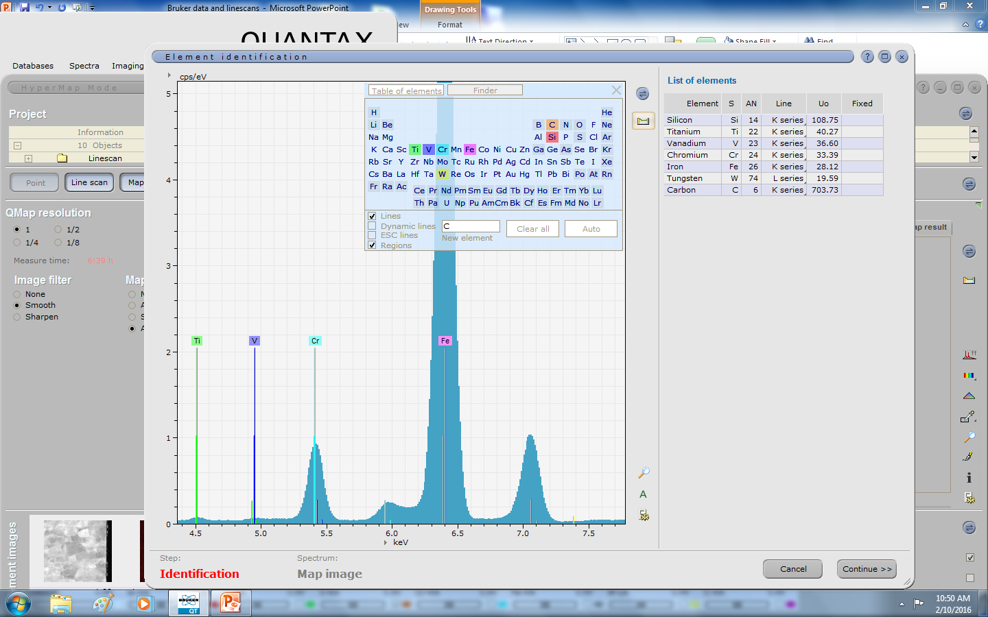
Select elements that match spectra, don’t leave spectra un identified as we must do proper qualitative analysis before quant

Slide 9
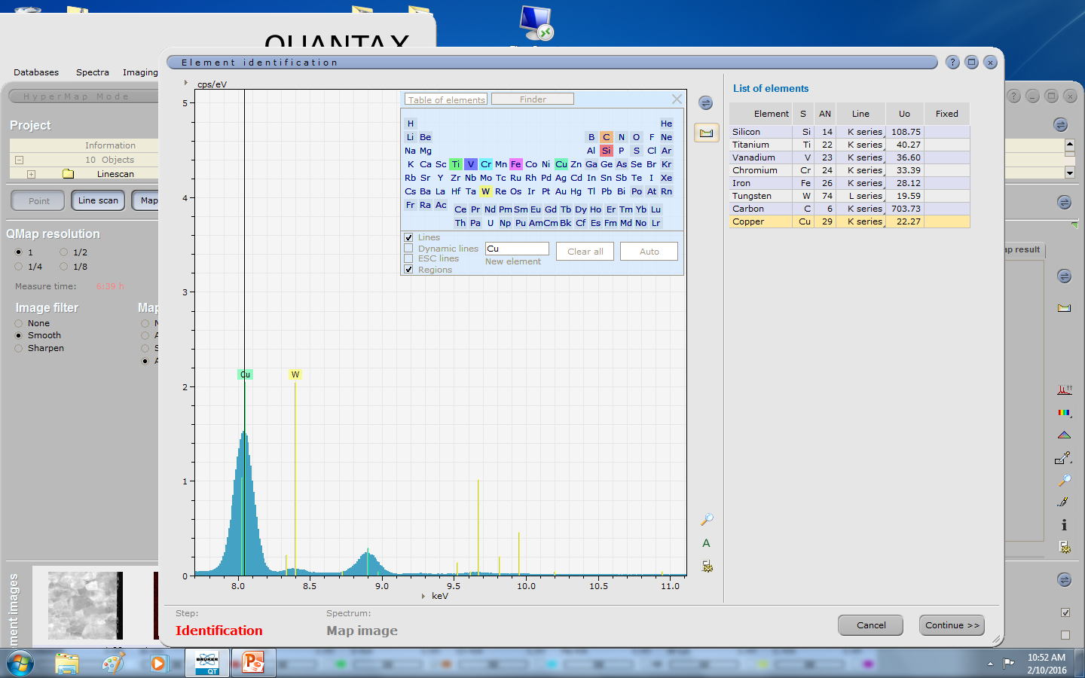
More id or qualitative analysis
Put in Copper, as it comes from the grid. It should be DE convolved or not appear in your final results

Slide 10
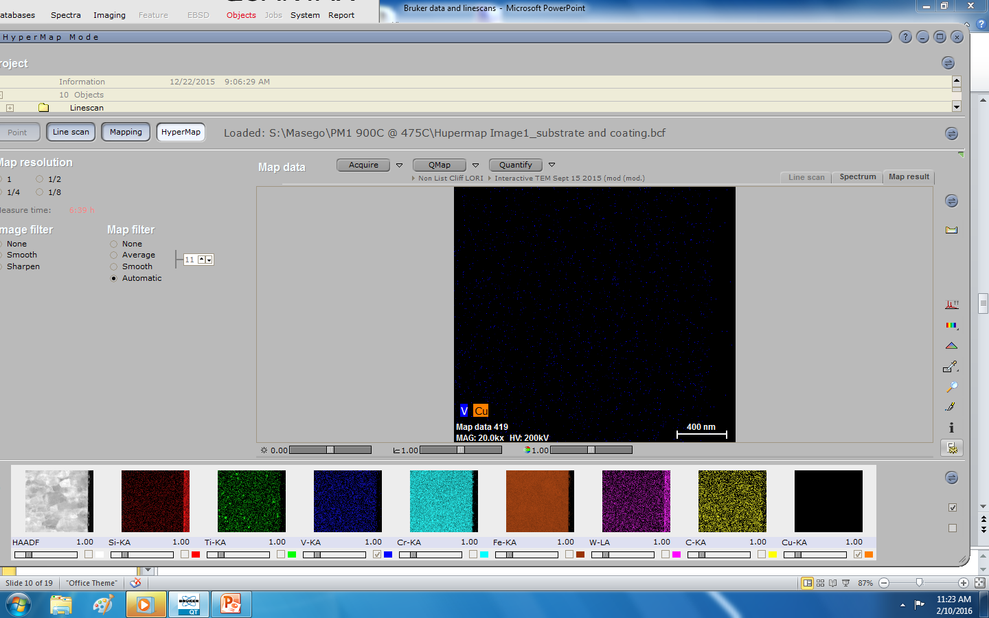
After Qmap, 20 minutes more or less, hit this button to change to atomic %

Slide 11
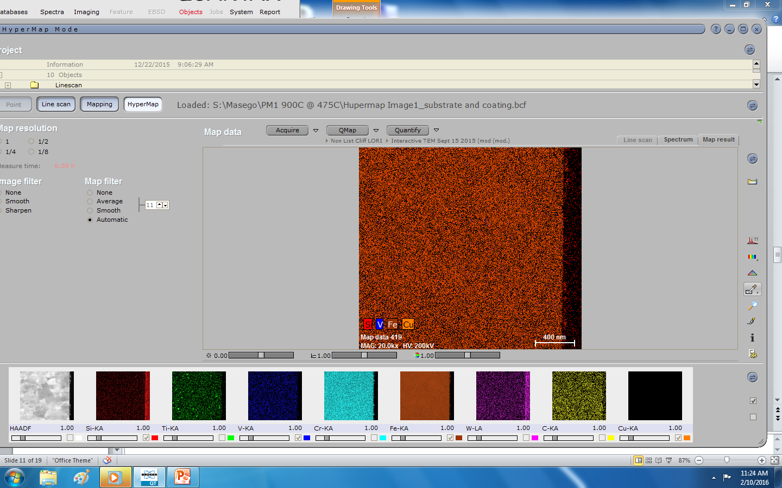
To generate a linescan, right click this tool and select line
By default it is a rectangle

Slide 12
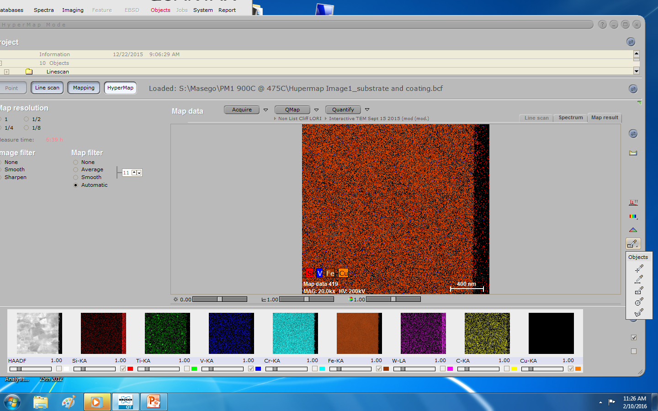
Select line

Slide 13
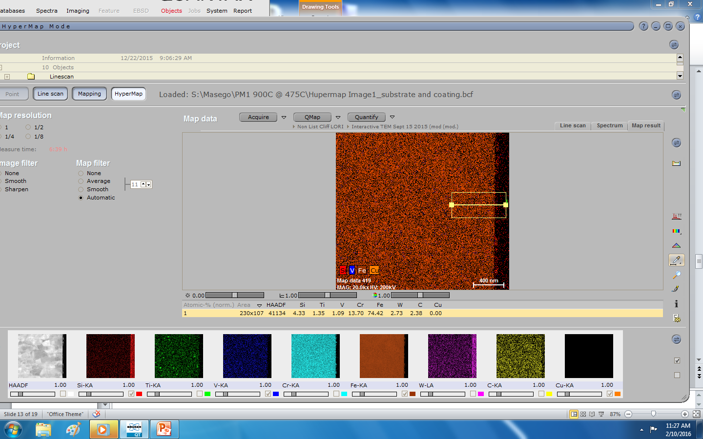
Now draw linescan use + key to make linescan box wider to increase S/N

Slide 14
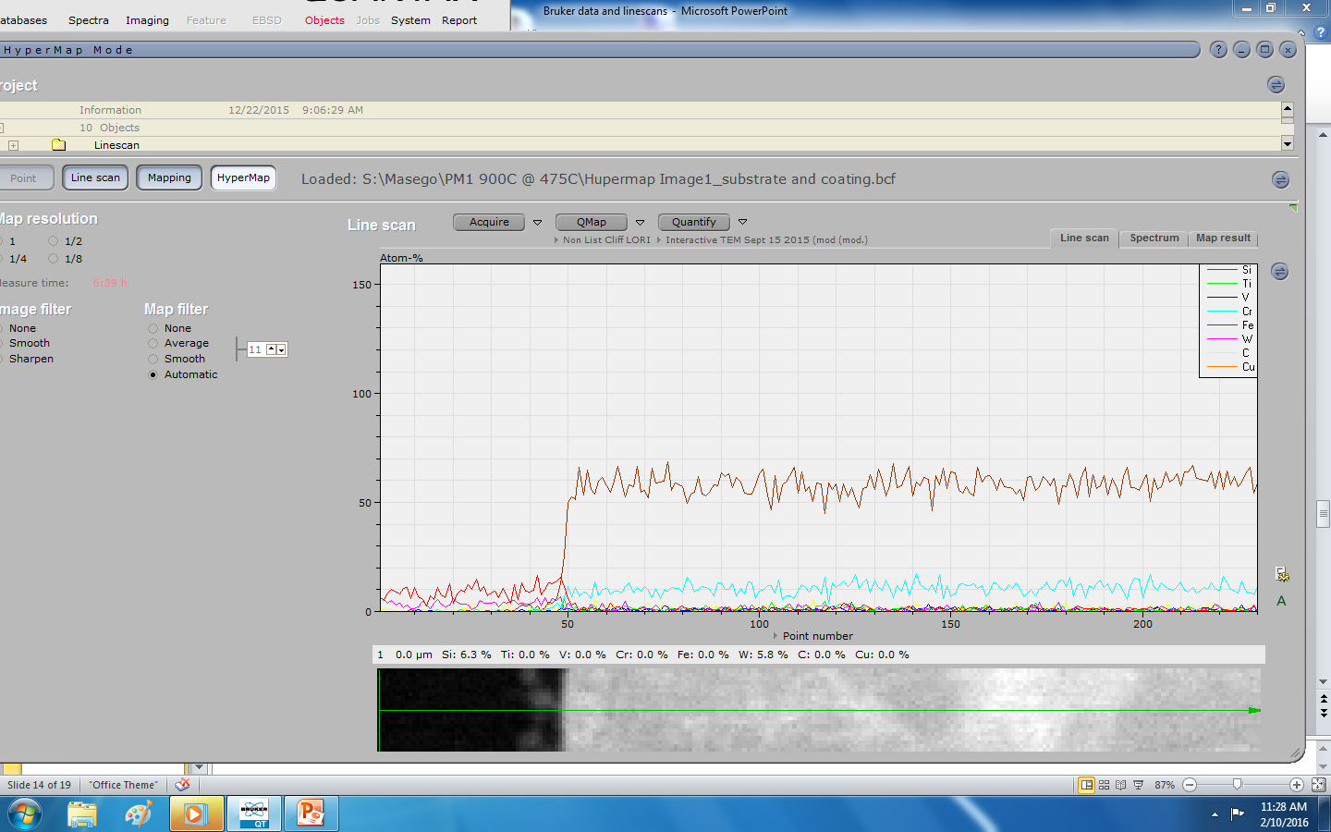
Click Linescan tab

Slide 15

Click here to select Point vs nm for x axis

Slide 16
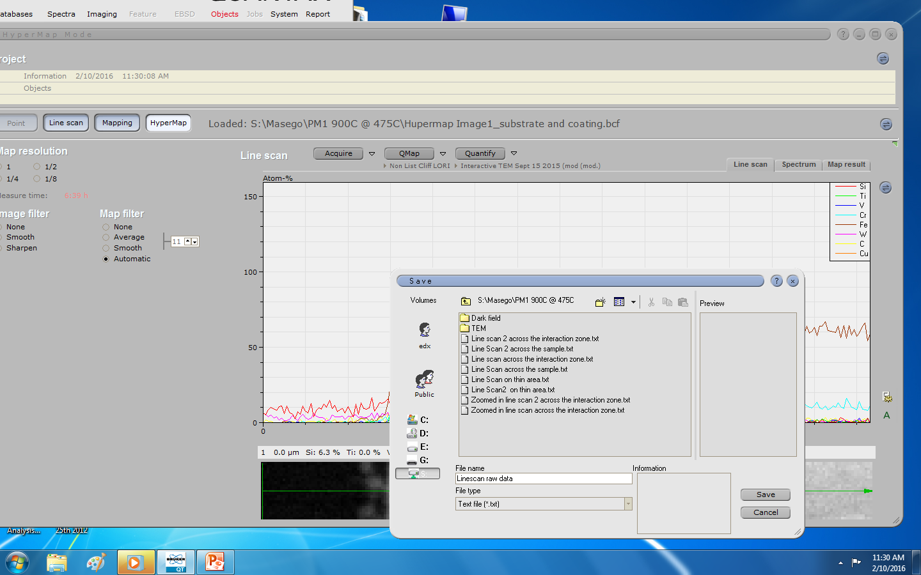
Save linescan raw data

Slide 17
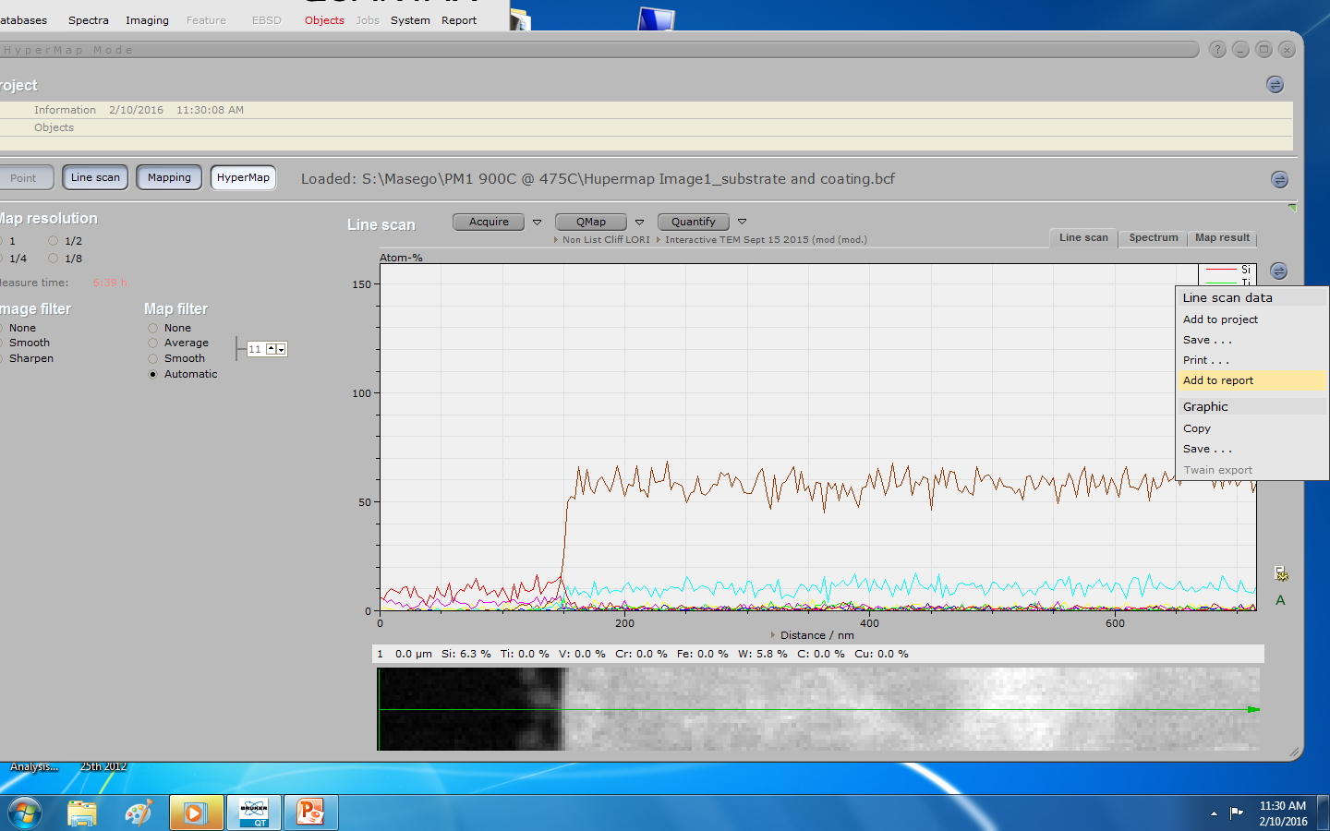
Add linescan graphics to report

Slide 18
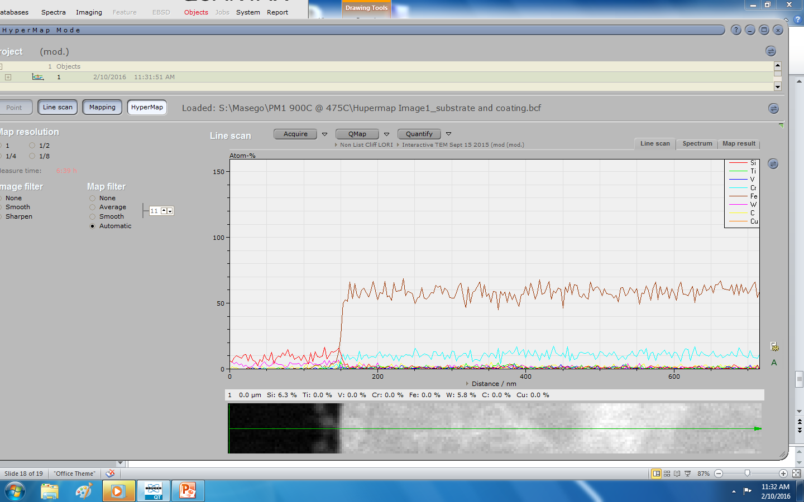
Add linescan data to project
Linescan data now in project

Slide 19
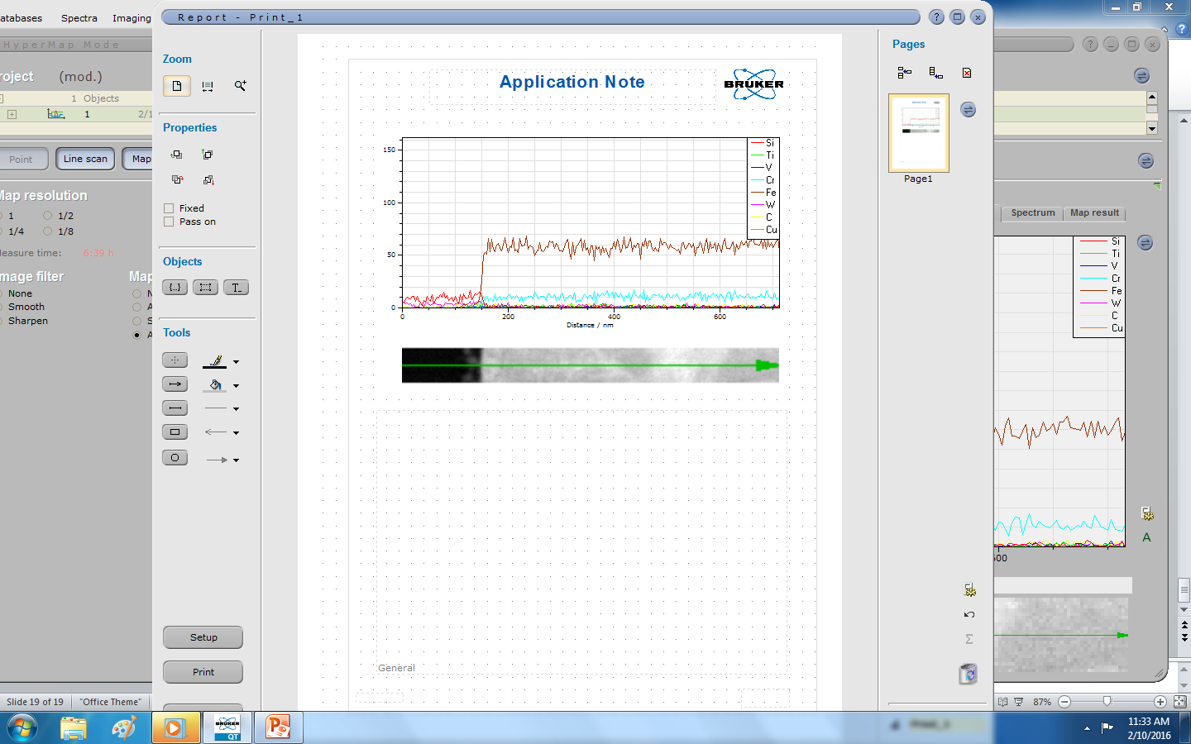
Data is in a report

Slide 20
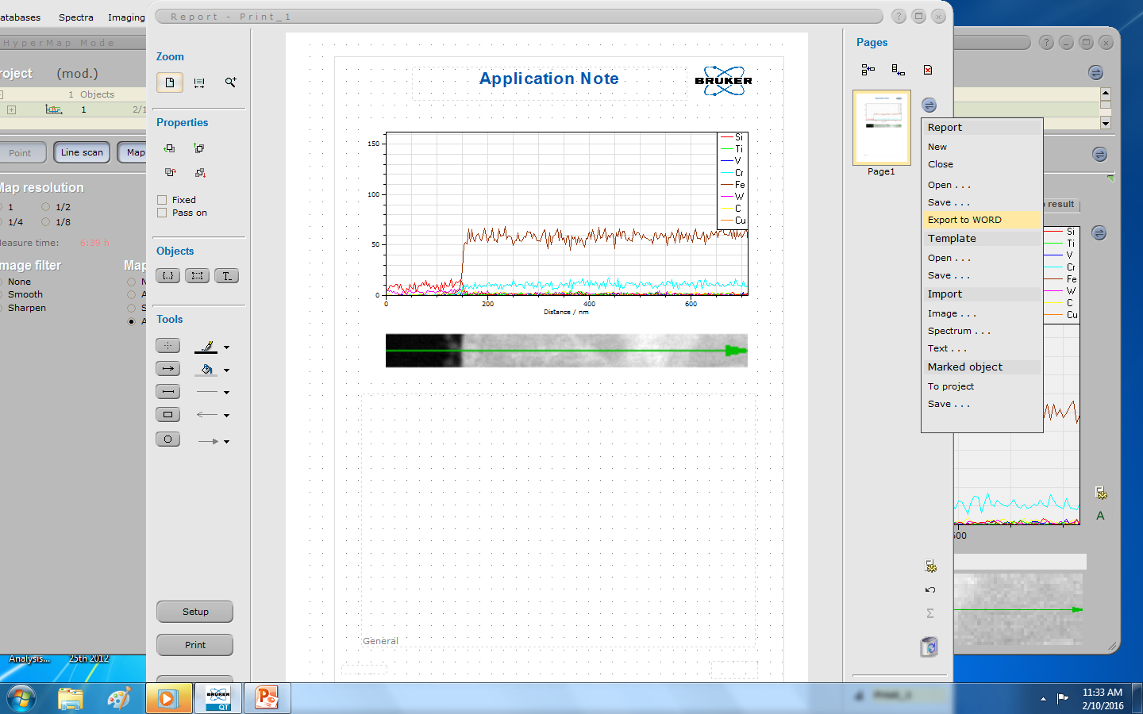
Click IO button and hit save to Word
IO button

Slide 21
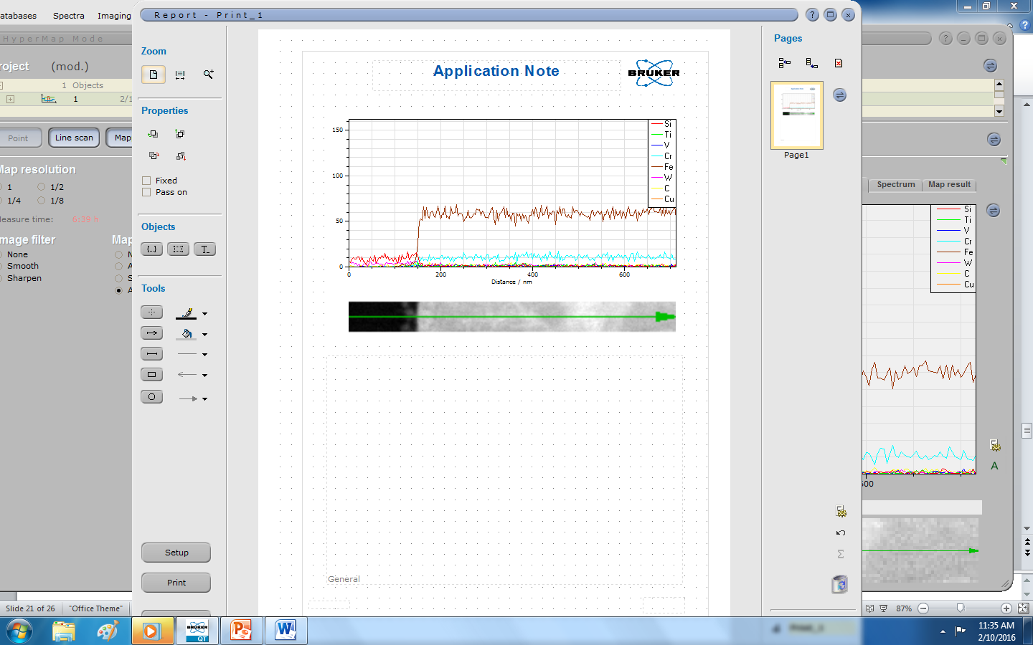
Click Word Icon to see your report in Word

Slide 22
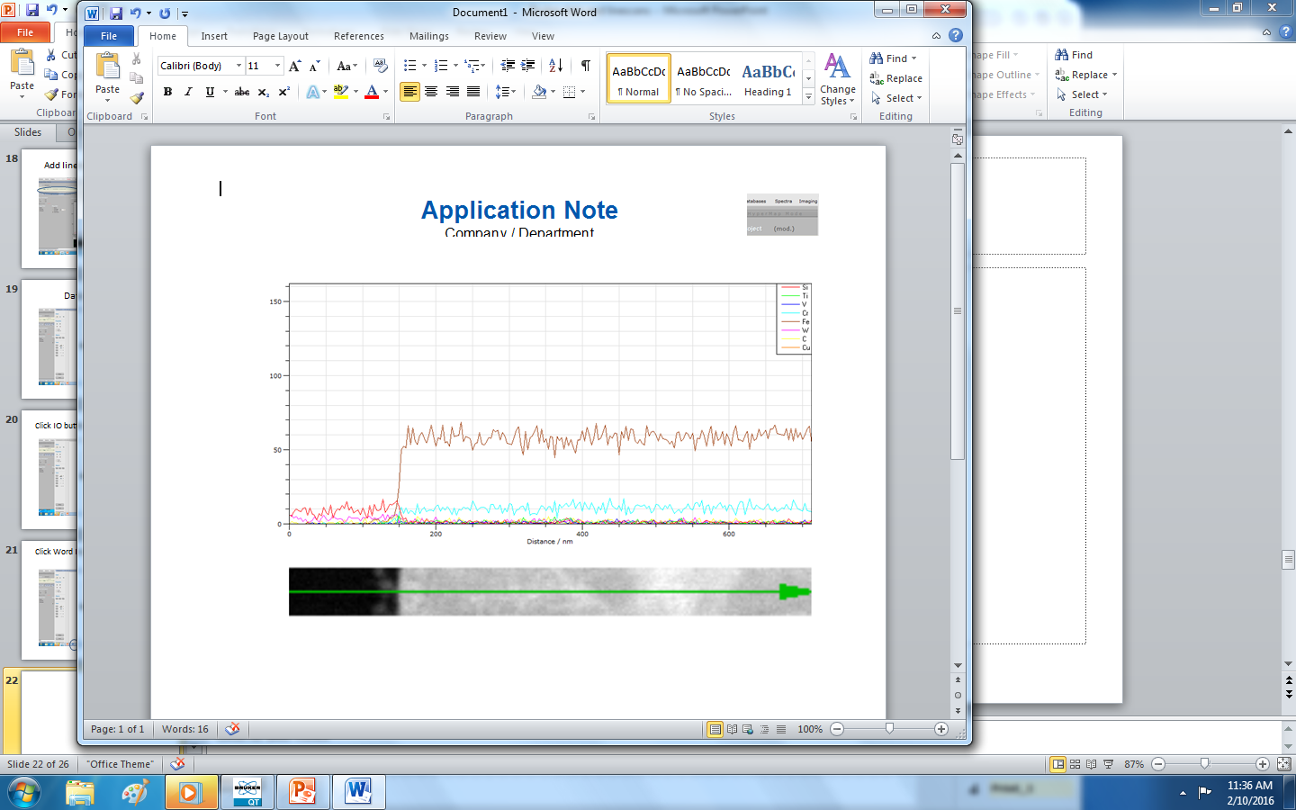
Now report is in Word

Slide 23
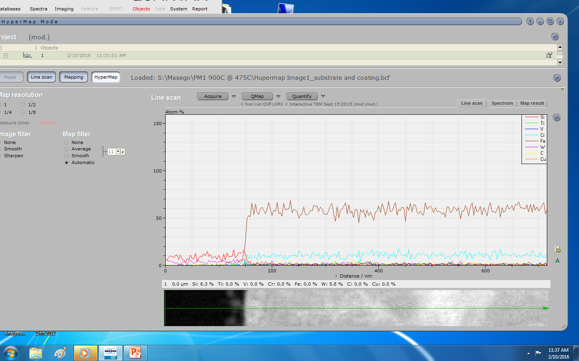
Managing Projects, Projects allow us to keep many linescans in one place for comparison later
Click here

Slide 24
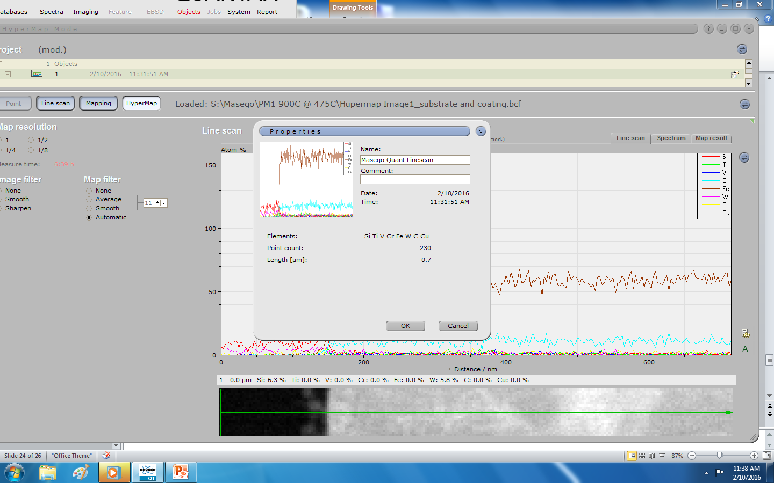
Rename linescan in project
Click here and
Give linescan a good name!

Slide 25
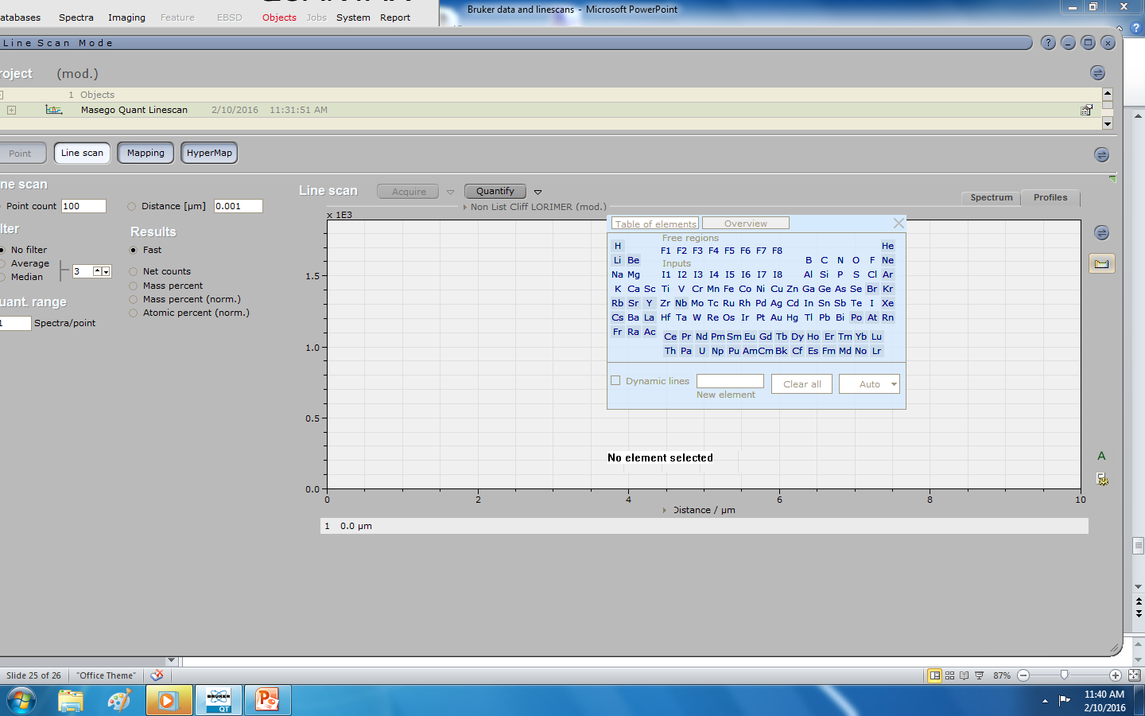
Linescans are dragged from project into Linesan window!
Drag this into window below!
Select linescan

Slide 26
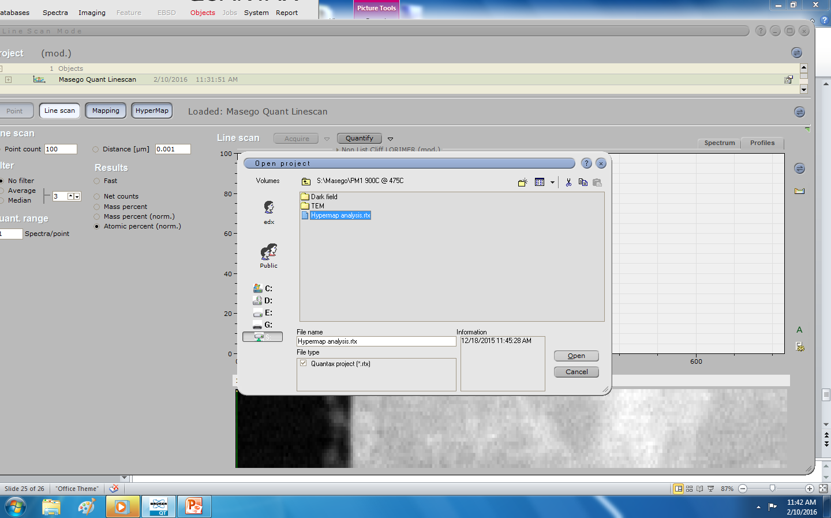
Opening Projects
Click IO icon for project slect open project.
Browse to project in this case Masego 475C

Slide 27
If that project is empty, it was not saved properly. But you can recreate the linescan with steps 1-14

Slide 28
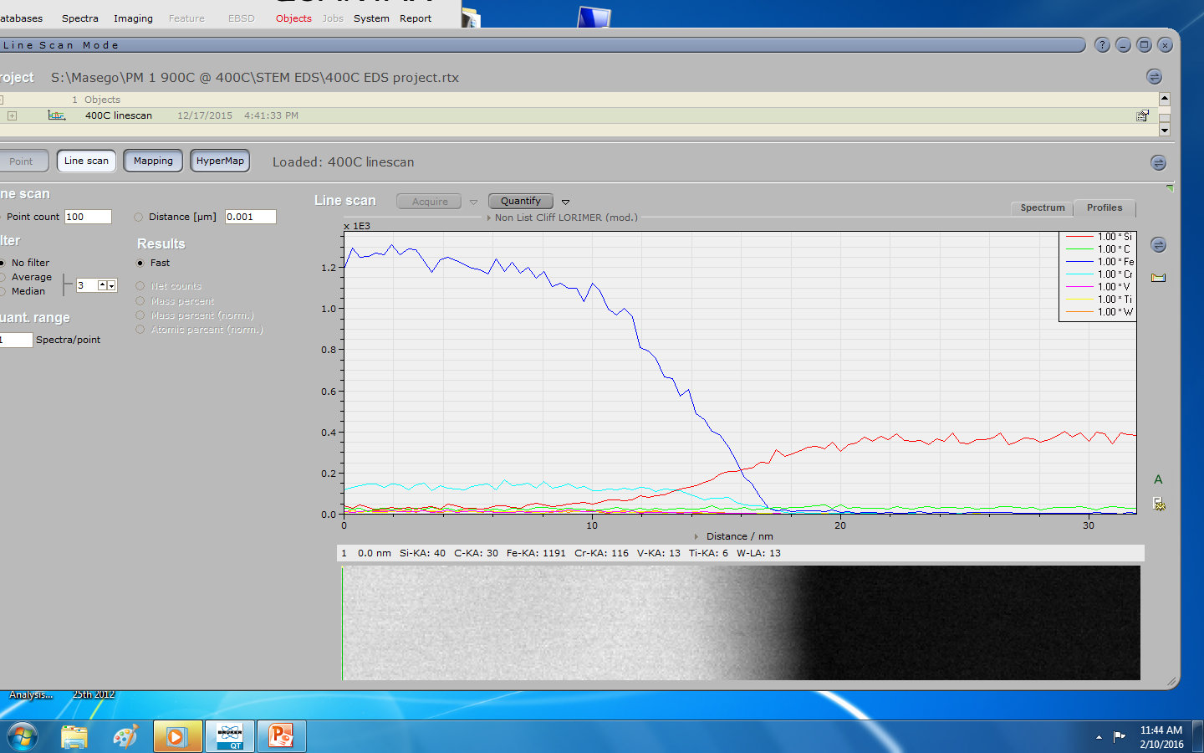
Example of good project 400C

Slide 29
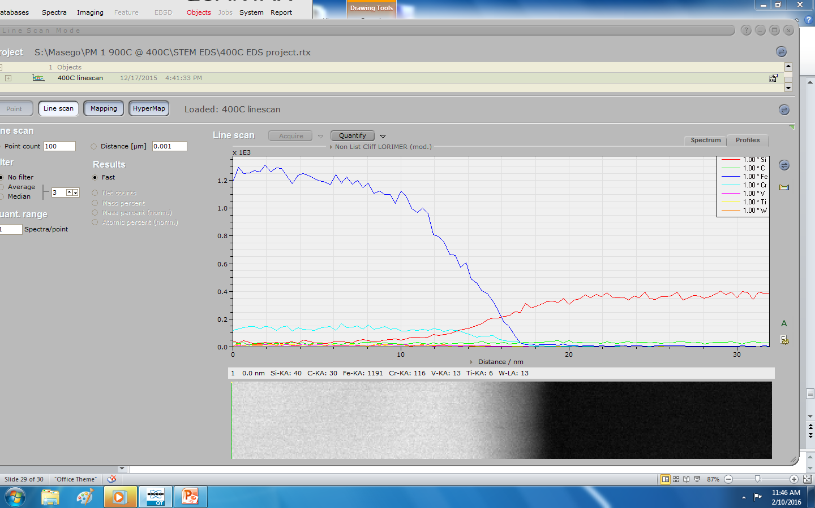
Add 400C linescan to report
Click here

Slide 30
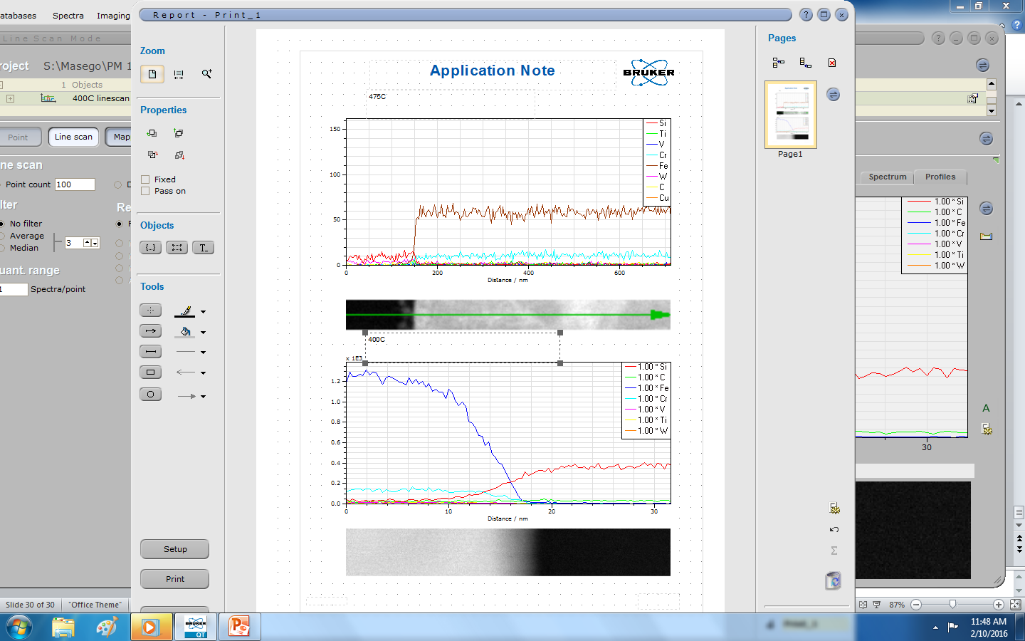
You can annotate report
With circled text tool I
Added 475C and 400 C label to linescans

Slide 31
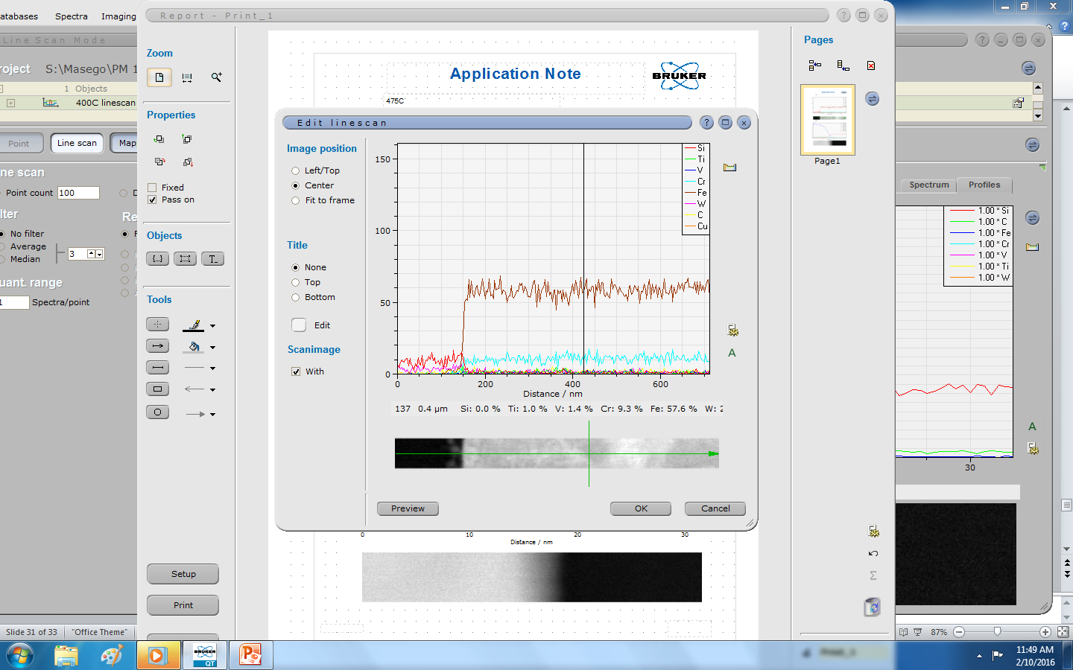
Reports are interactive! Double click on graph

