Slide 1
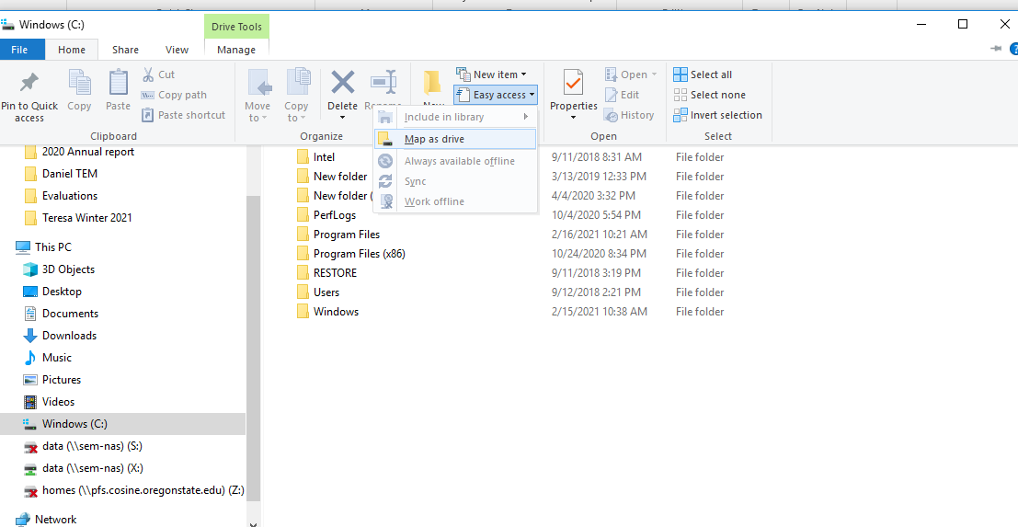
How to map a network drive
1) Go to windows explorer, home menu, easy access, Map as drive

Slide 2
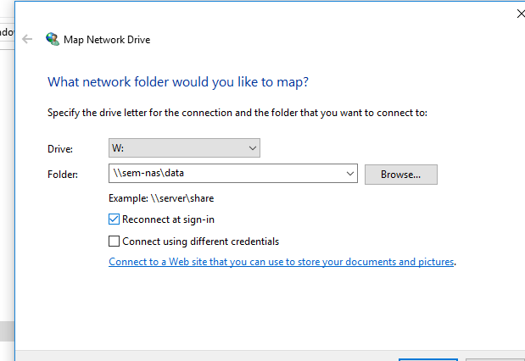
2) Now select a drive letter, type in \\sem-nas\data as below, click on reconnect at sign-in

