Slide 1
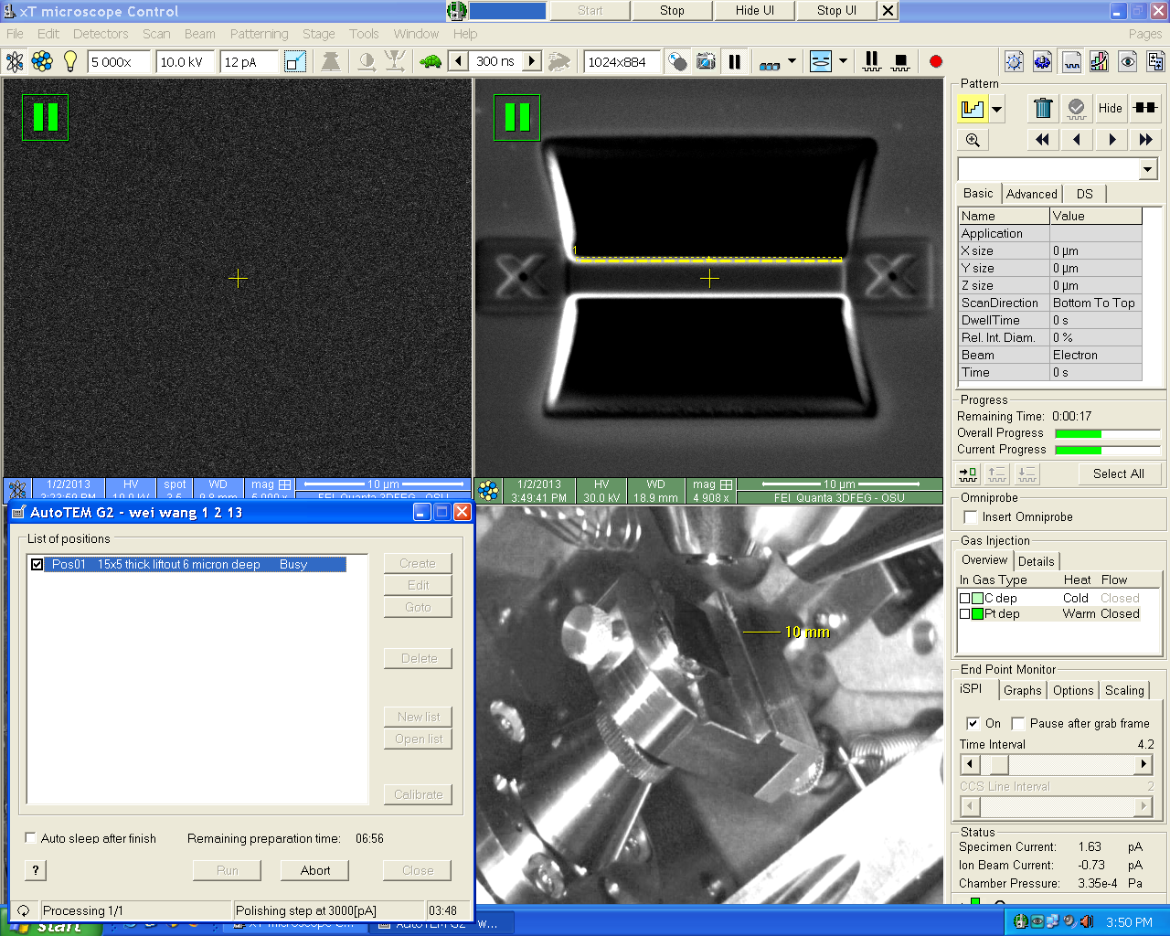
TEM Sample preparation using an FEI dual beam focused ion beam (FIB)
Tricks of the Trade:
Zero drift is imperative especially for thinning the sample. So, coat your samples well. Three films work best: 15 nm of Carbon first for delineation, 30 nm of Chromium on that for hard mask then .5 um of area specific FIB platinum over the Chromium. The Platinum provides a fine grain mask to reduce FIB curtains, it also allows us to see how fast the sample is thinning in iSPI mode. Glass samples: put ground straps of Cu tape on then coat!
Next is the mantra of dual beam prep: Confirm Eucentric by tilting and looking for sample to move. Focus at 52 degrees, link. Then make the ion beam and electron beam coincident!
Before inserting a needle, check to make sure working distance is above 9.8 mm. Otherwise, needle and or GIS collisions with sample are possible.
Remember three things: Eucentric, Focus at 52 degrees - Link, and ion beam – electron beam coincidence.
Be the beam, pull out your cell phone as model, tilt your mock sample in your hand as if it were the sample in the chamber. Visualize where the electron beam and ion beams are. For an advanced skill, look at where the detectors are in the chamber. Study backside and frontside on page 4.

Slide 2
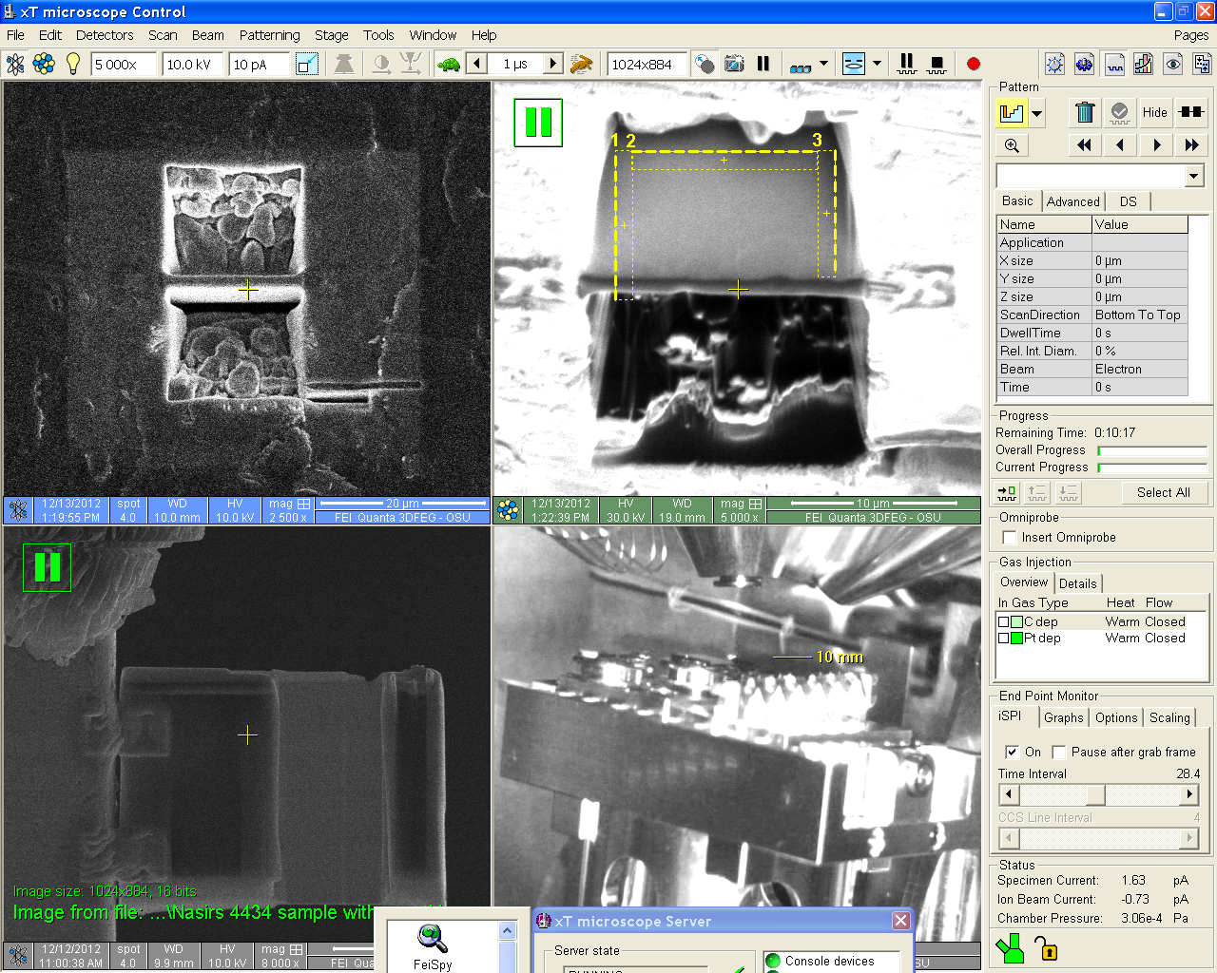
Conventions used, Backside 7 degree tilt
Maximum implant occurs at this step on backside ion face is up
Ion
Electron
Electron beam
Ion beam
Backside
detector
0 < back < 52 degrees
7 degrees
Ion beam and electron beam are on opposite faces

Slide 3
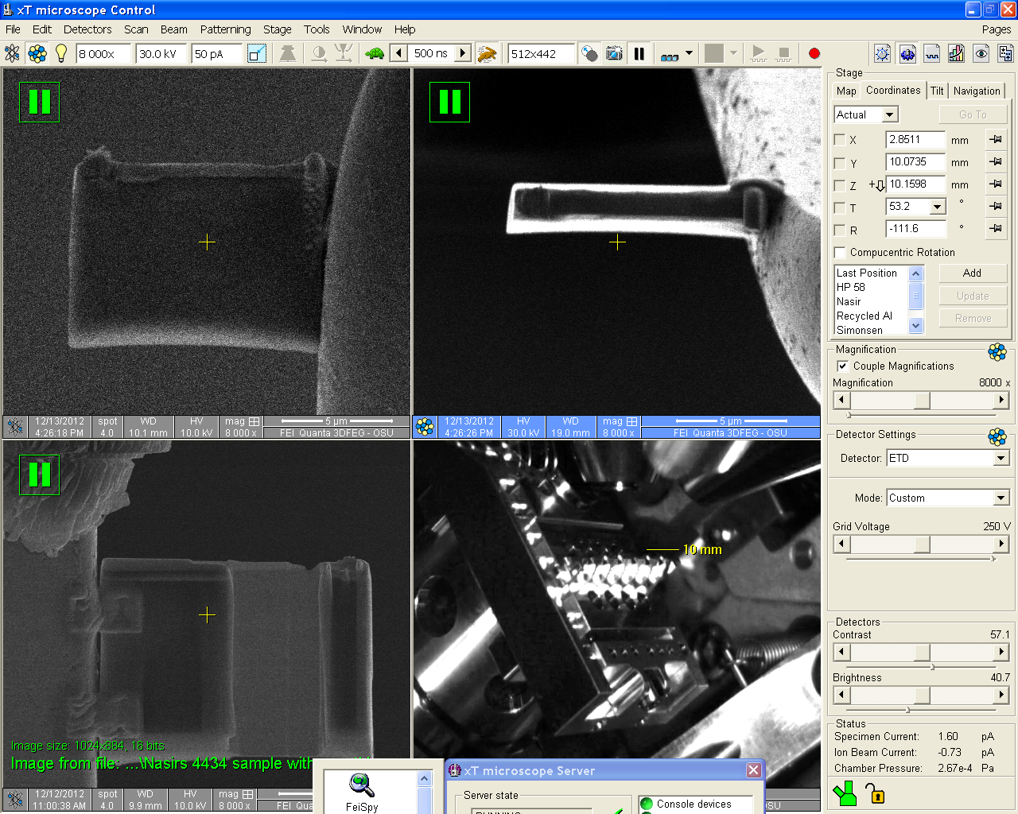
Frontside 53.2 degree tilt
52 < front< 60 degrees
The electron beam is still viewing the frontside
Now the “flare” from face is on bottom or ion beam is striking the frontside
Electron beam
Now the ion beam and electron beam are now viewing the same side.
Ion beam
detector

Slide 4
Summary backside and frontside
This is a convention used by the Author. It is historical for him, having been trained at HP where 0 to 52 degree ion beam work is called backside.
You can use ANY convention you want.
Just realize that the maximum ion beam implant occurs when you grab a relatively high current Ion beam frame ( 1 nA) at 7 degrees to perform your J cut. If you don’t like calling it the backside, you can call it the damaged face!
Frontside processes
Backside processes
Electron beam
Electron beam
Ion beam
Ion beam
detector
detector
Tilt greater than 52 degrees.
Tilt less than 52 degrees

Slide 5
Now start Auto TEM
Select 15 x 5 Thick liftout 7 micron deep
Focus at 52 degrees and set Eucentric Before running as needle will come in!!!

Slide 6
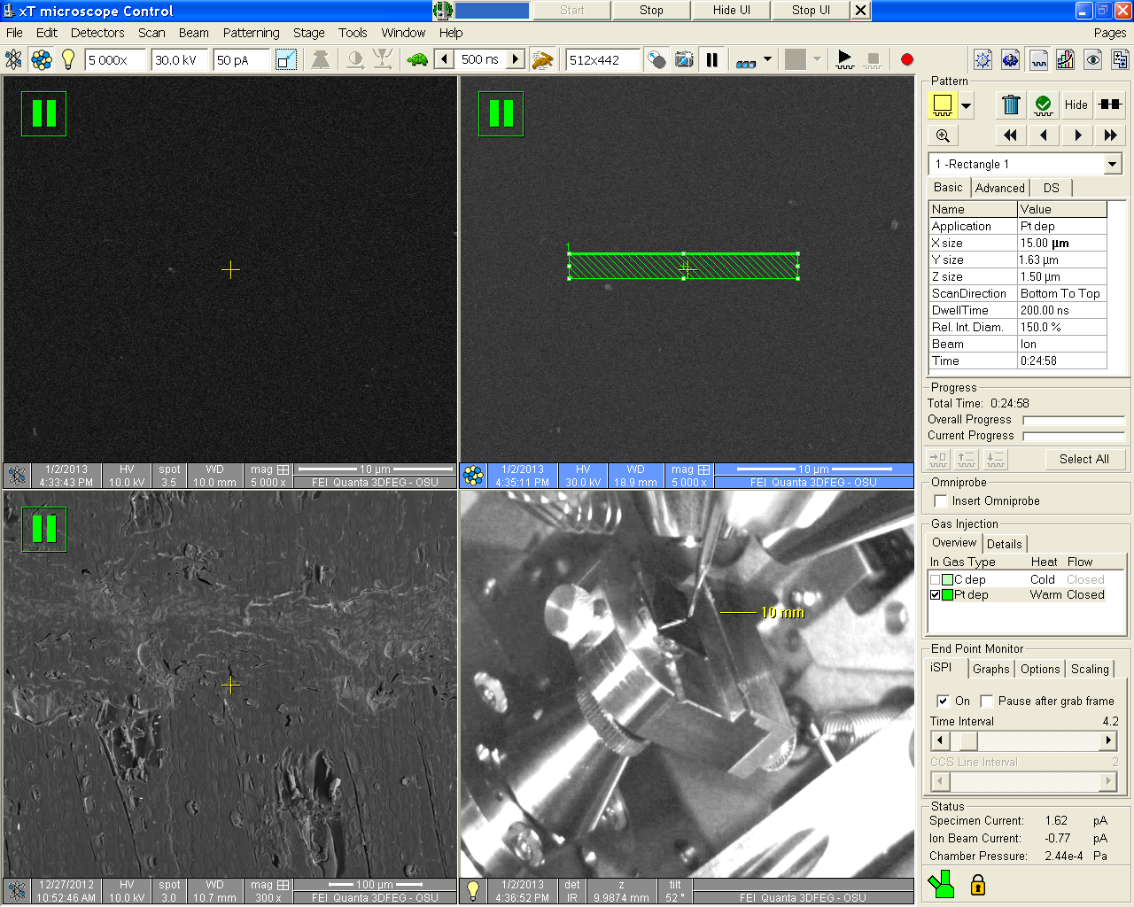
If Auto Tem fails, put your Pt down at 2-6 pA/um^2

Slide 7
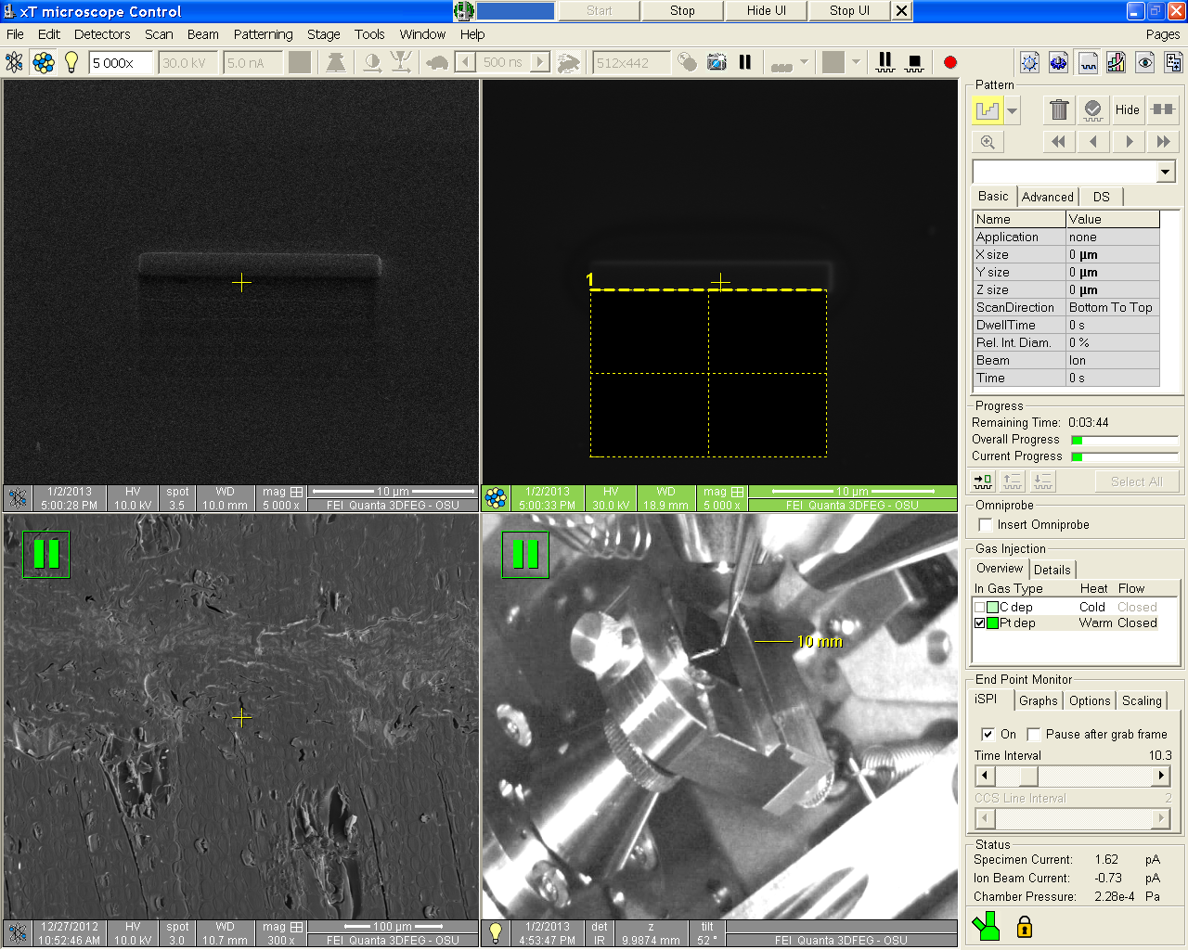
If Auto TEM fails, use “Hog Out” cut or regular Cross section at 5 nA

Slide 8
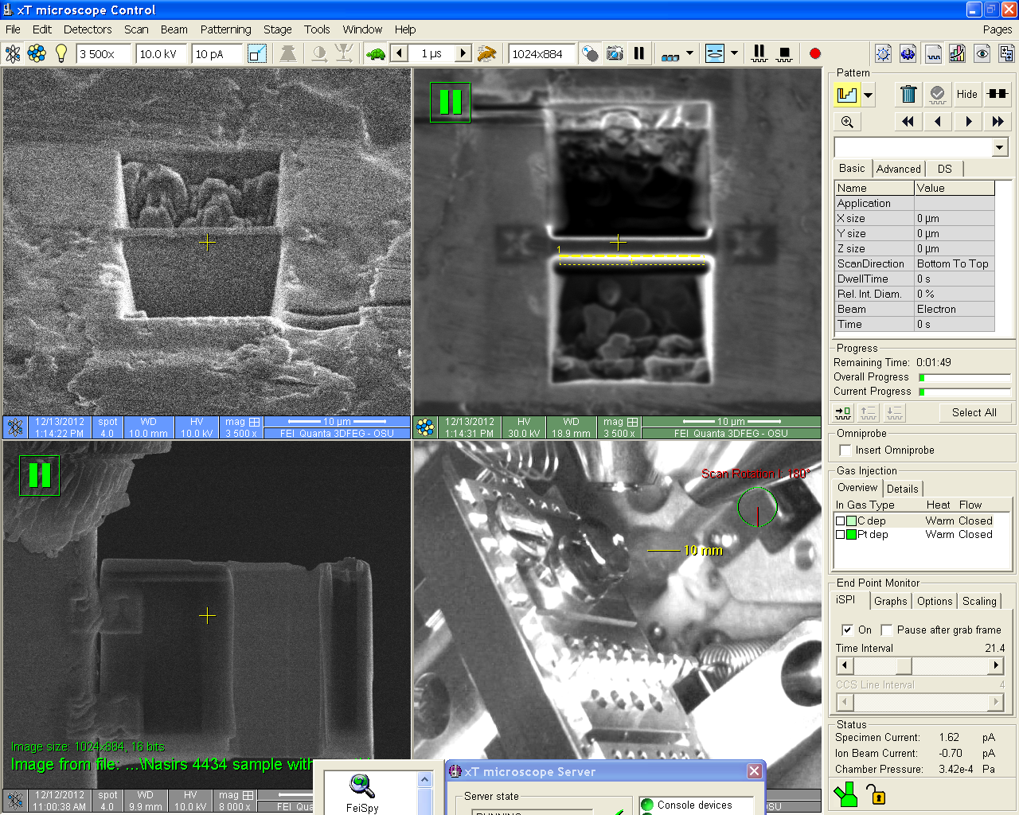
To thin backside we scan rotate the ion beam 180. Then use hog out cut.
Cleaning cross section shown here

Slide 9
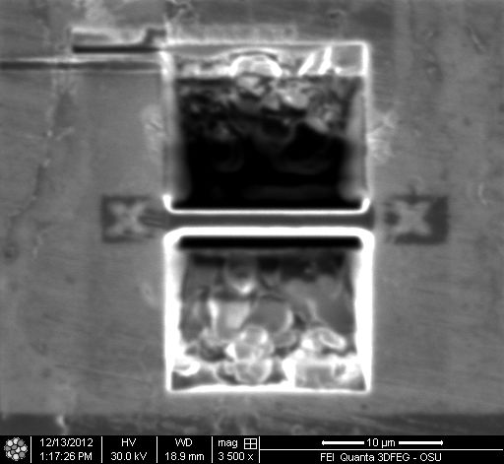
Ion image of membrane ready to tilt back and perform J cut

Slide 10
Now that membrane is cut, tilt back to 7 degrees, net 45, and place J cut.
“backside” of sample, it receives the maximum dose

Slide 11
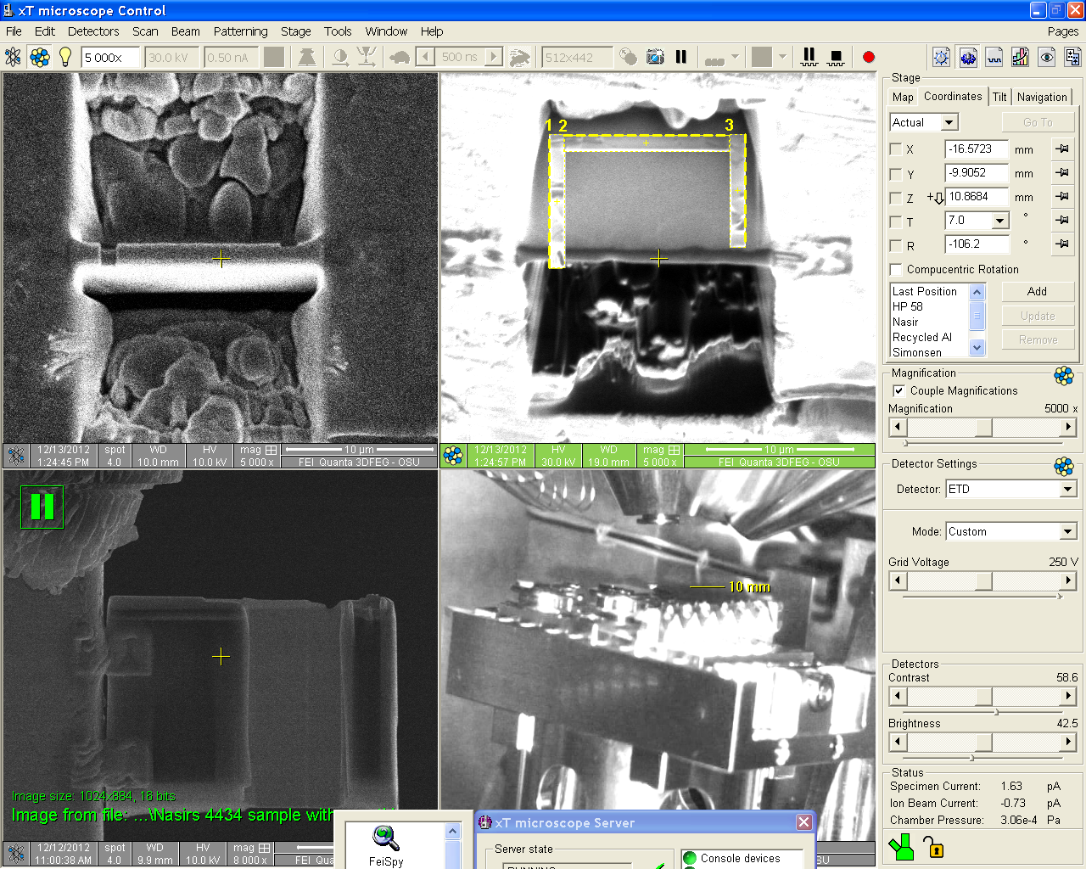
Monitor J cut with iSPI on electron side and real time monitor on Ion side

Slide 12
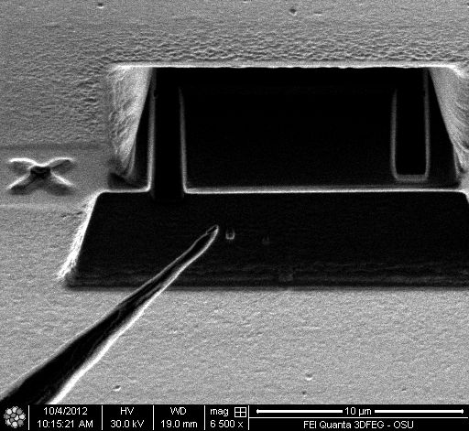
The Ion view images that follow are taken from Quick Time movie on the EM facility website instruction and training area: http://www.science.oregonstate.edu/emfacility/?q=node/ED

Slide 13
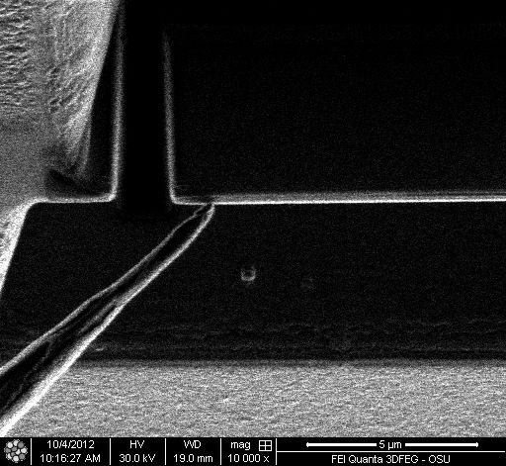
Contact the surface
Grab an electron frame to make sure the needle is on top of the sample

Slide 14
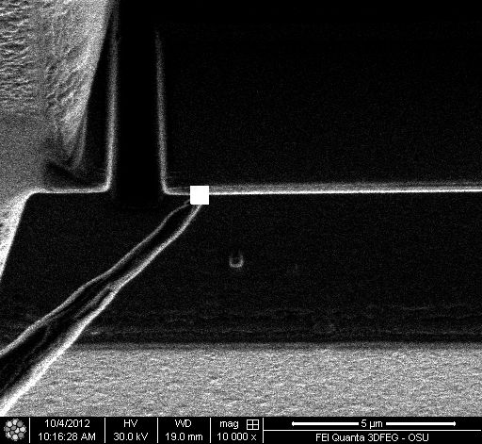
Weld the needle to the sample, remember 2-6 pA/cm²

Slide 15
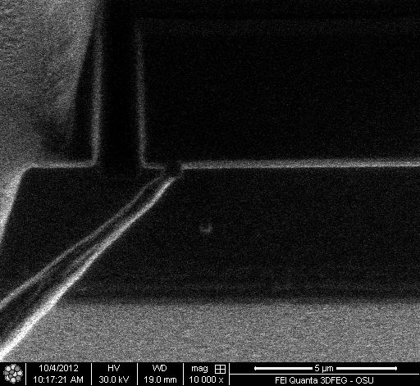
Weld is complete now and we are ready to cut free and liftout

Slide 16
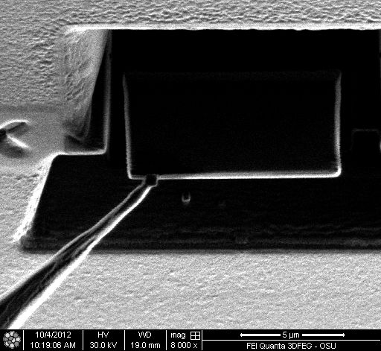
Use Z+ on controller to start liftout, so called Zig
We cut free

Slide 17
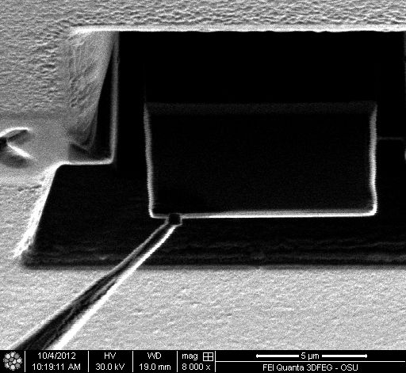
Now Zag or move with the Y+

Slide 18
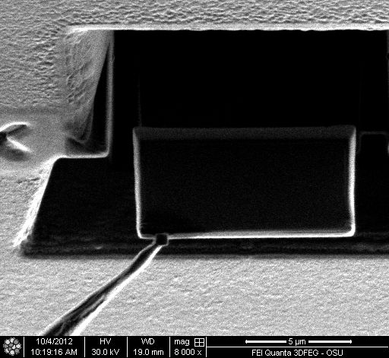
Now Zig one more time, Z+

Slide 19
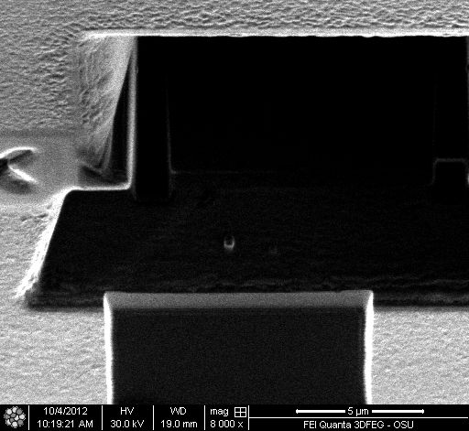
Zag or Y+ to clear the trench, in this manner we zig zag zig zag* to clear the sample
*An alternative method involves having matched Z+, Y+ speeds and pressing both at the same time. You have to be sure speeds are matched!

Slide 20
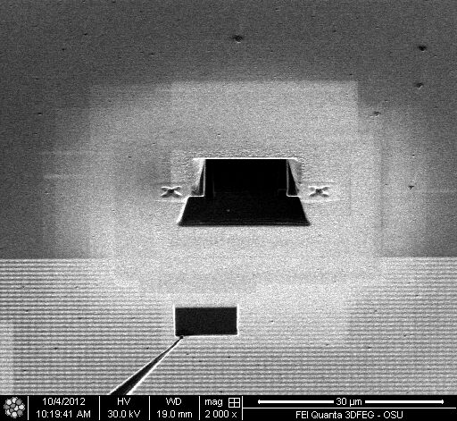
Now trench is cleared so you can increase speed and remove with Z+ and Y+ held down together or just Z+ to lower left corner of lowest ion view mag.

Slide 21
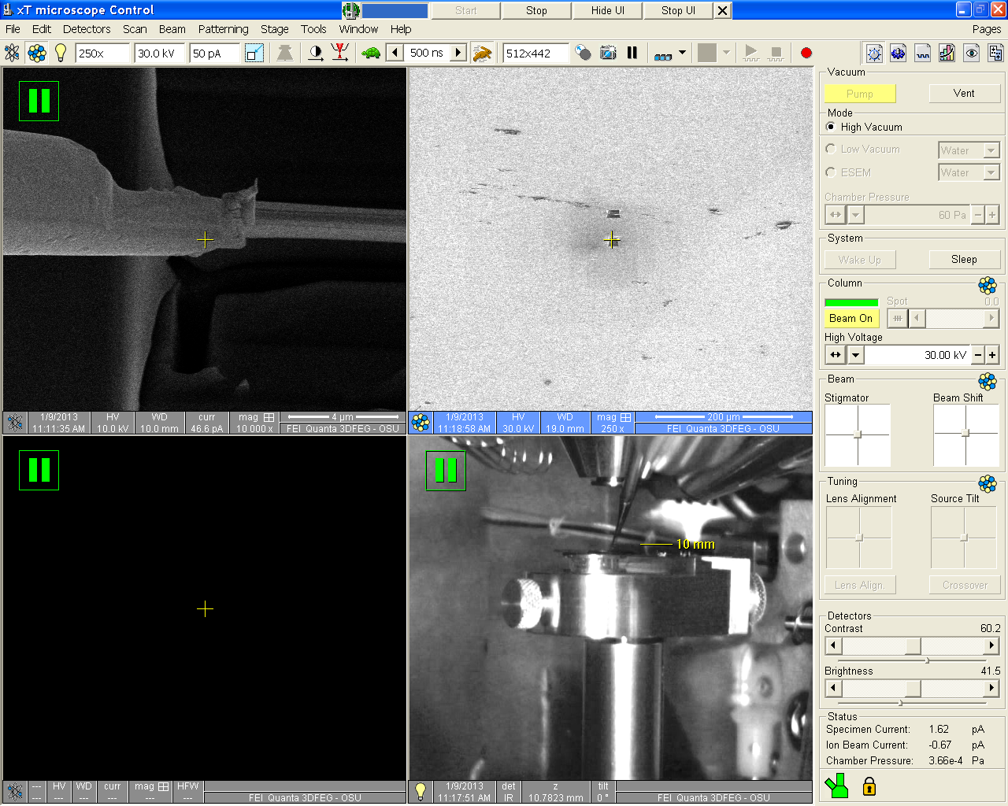
Once welded to sample, now pull Omni needle back to lower left corner of the lowest magnification Ion image
Now that Pt GIS is out you can retract Omni.

Slide 22
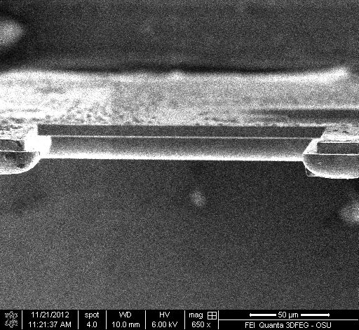
Electron Image, the grid is moved so sample will insert safely
Safe landing zone
Is this an ion image or electron image? What is tilt angle?

Slide 23
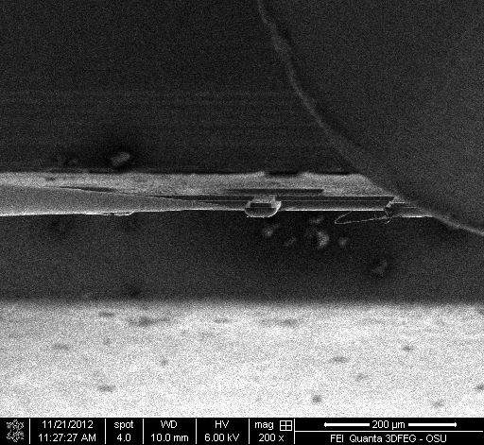
Don’t forget to insert Platinum GIS before you get too close!
Pt GIS
Electron image! And we normally do weld and un weld at 0 degrees

Slide 24
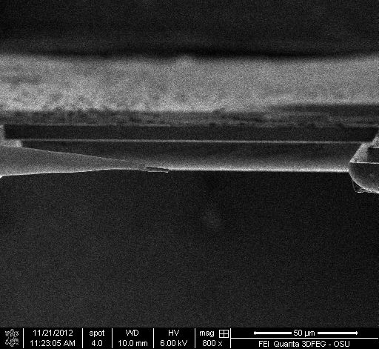
Position sample so center of image (eucentric height) is in between two grid fingers now insert the omni needle
Grid finger to weld to
With sample near center we can mag up without losing track of sample!
Electron image

Slide 25
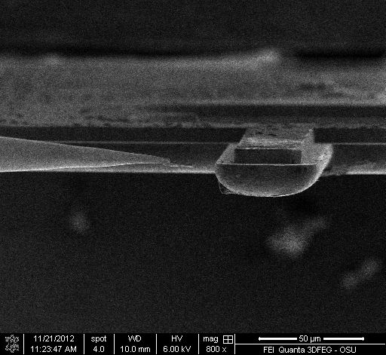
Final electron image check, move grid finger towards sample with knobs on the SEM FIB, then adjust alignment of sample to finger with X controls on Omni probe controller so that sample will contact finger on a flat area.

Slide 26
These Ion Images that follow of Welding the Lamella to the Omni grid are from the EM facility Instruction page quicktime movie titled “TEM lifout welding to omni grid.” http://www.science.oregonstate.edu/emfacility/?q=node/ED

Slide 27
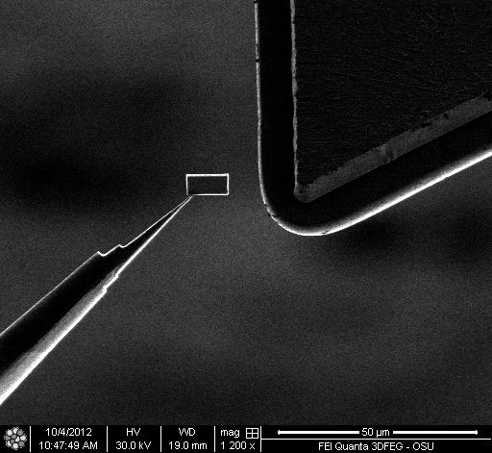
Now that finger was brought to center with knobs on FIB, we bring the sample to the finger with Omni controller

Slide 28
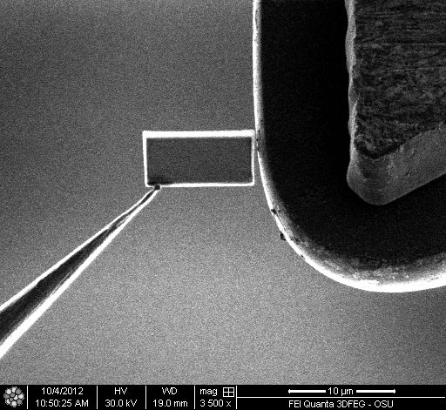
Increase Magnification, move sample to within a ½ micron of finger or touching with the Z- and Y- controllers on omni controller.
This position maximizes Platinum gas glow around finger yet protects the sample, its now between fingers A and B and recessed from edges. Try your own positions if you like!
Omni grid
sample
Pt flow
GIS over here

Slide 29

Now draw a Pt rectangle and perform a tack weld. Remember 2-6 pA/cm^2 or for this size weld probably the 10 pA aperture and 30kV!
There are many weld strategies. In this case the sample has a gap and so one tack weld was used. One was used as sometimes the weld process will pull the sample flush and eliminate the gap. Then a second weld higher up on the interface will be more effective.

Slide 30
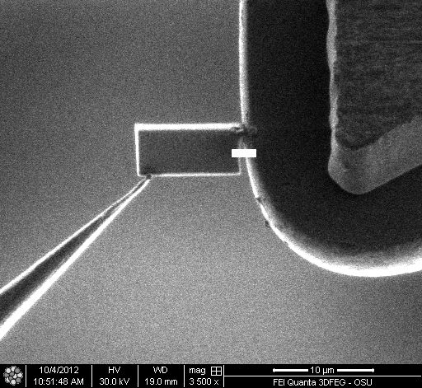
Weld
Second weld is progressing

Slide 31
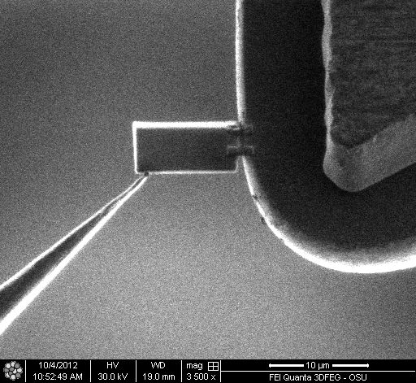
Two good welds. We could un weld at this point or we could add reinforcement
In retrospect the two welds could have been done in paralell

Slide 32
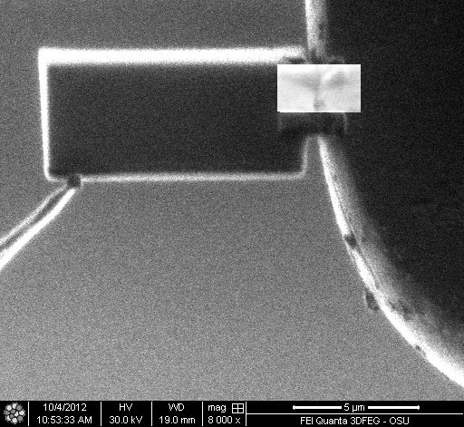
I chose to add a third weld of large area with 50 pA aperture

Slide 33
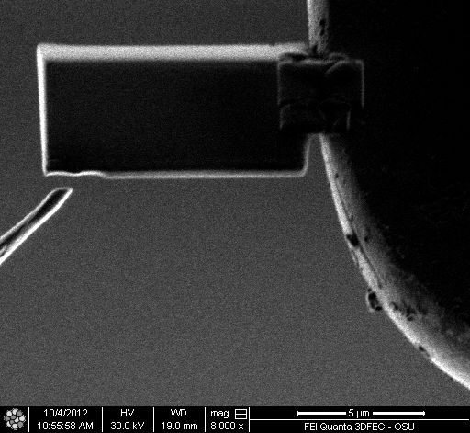
Now cut free and proceed to thinning
Notices the thick Pt reinforcement weld
Drew a rectangle, changed to Si and selected a larger current, .3 nA and cut free!!!

Slide 34
Thinning
Frontside thinning at 53.2 degrees 30 kV and 50* pA with cleaning cross section
Backside thinning at 50.8 degrees 30 kV and 50 pA with cleaning cross section
This gives the sample an upside down pyramid shape and so the top films are slightly thicker. This protects top films when thinned to electron transparency and compensates for any beam de focus down into sample.
Polish is done at 5kV and 47 degrees back, 57 degrees front!
* To hurry prep up, you can use 1000 pA to thin, but you have to be very careful. Another strategy is to use 100 pA for 75% of the thinning. Then halt the pattern, change to 50 pA and restart patterning to finish at the lower current. When speeding up thinning, use of iSPI mode is highly recommended!!!

Slide 35
Membrane now welded to grid. Sample is tilted to 53.2 degrees or dead center plus 1.2 degrees to thin frontside

Slide 36
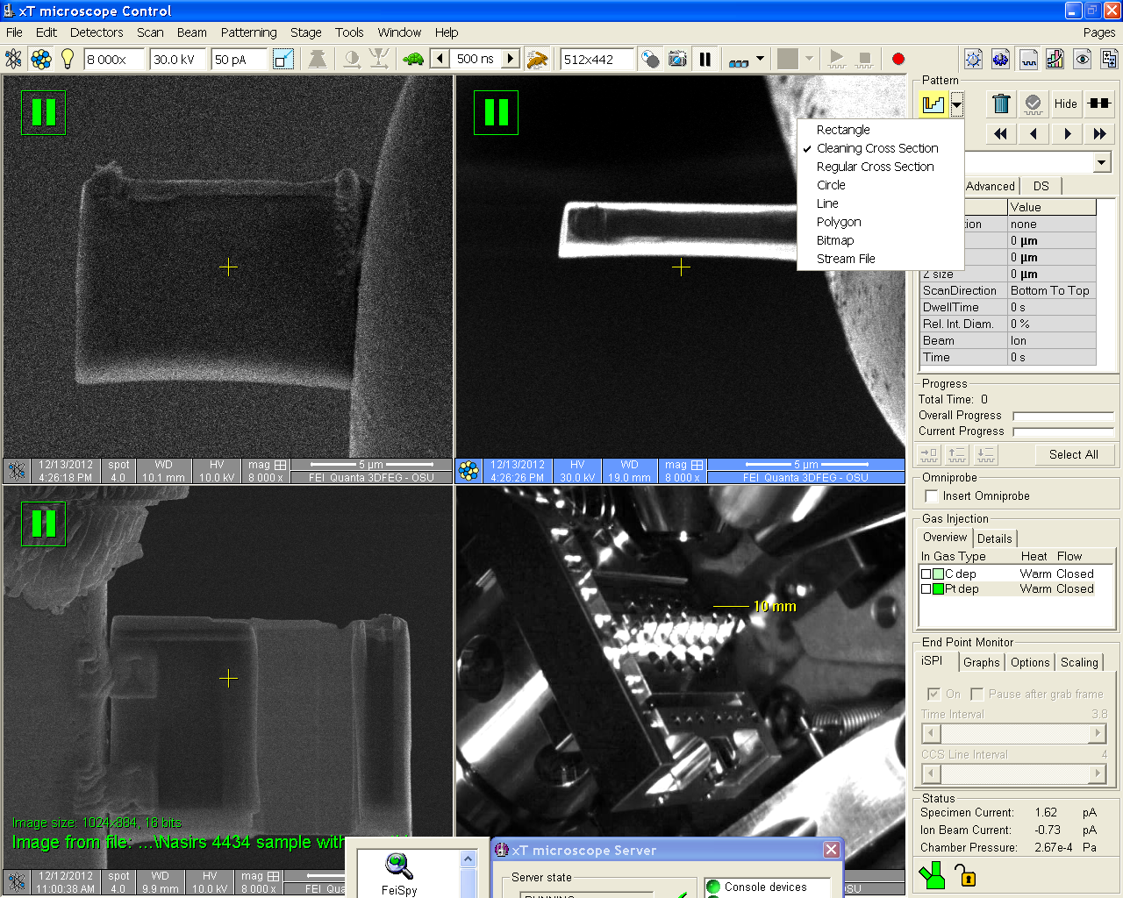
Select Cleaning Cross Section

Slide 37
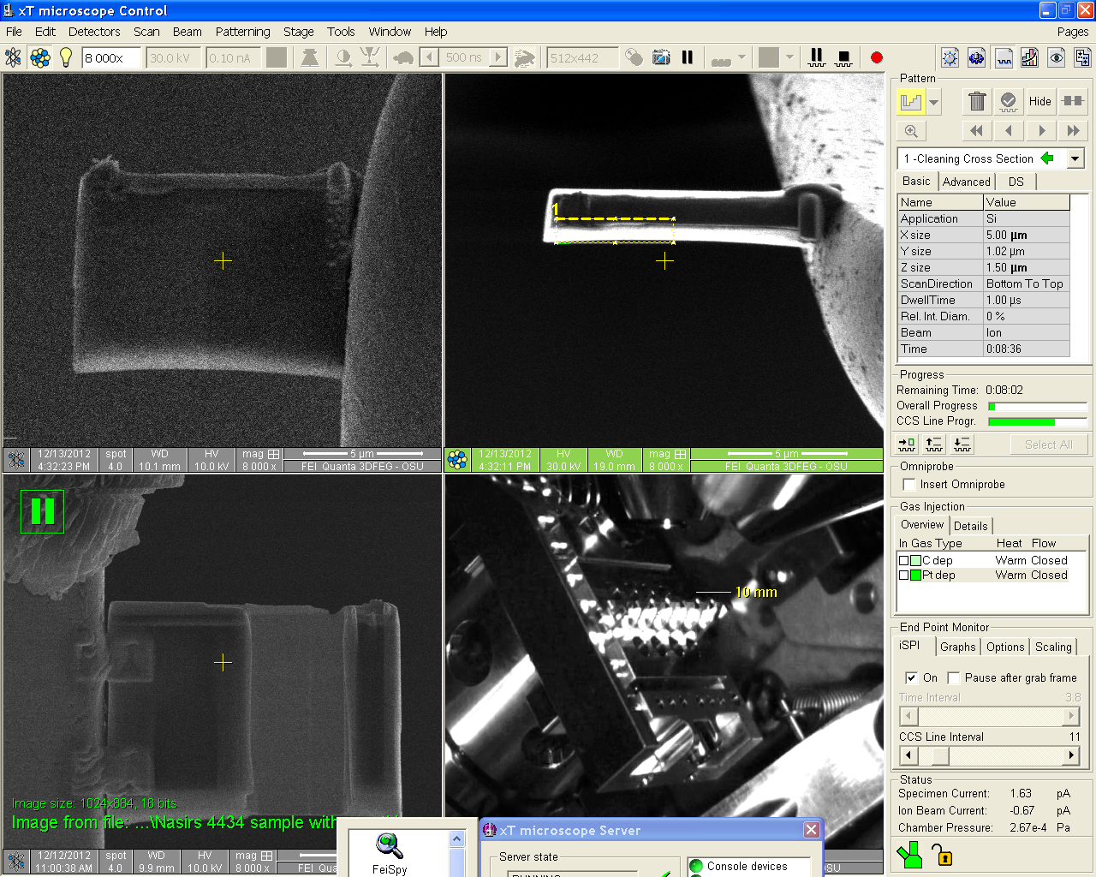
First thinning box on front side at 53.2 degrees

Slide 38
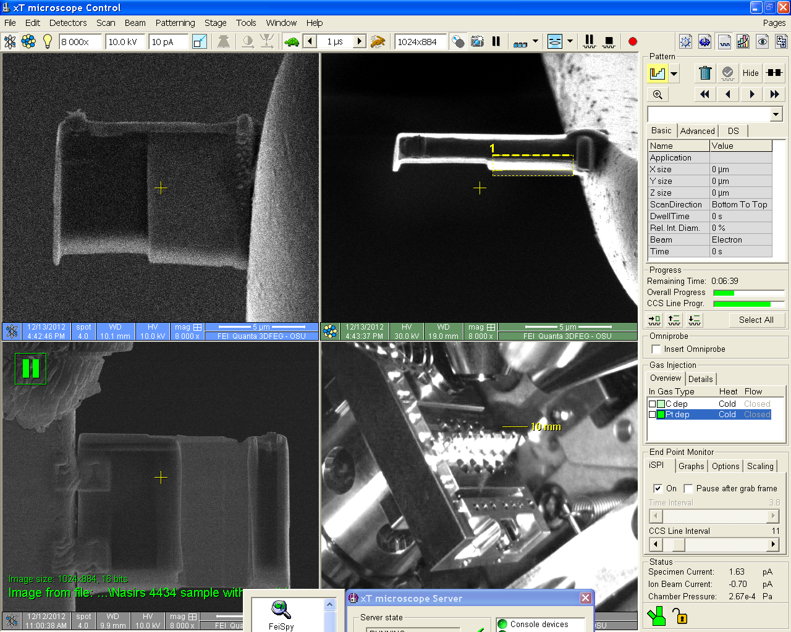
Two thinning window method to prevent sample warping still 53.2 degrees

Slide 39
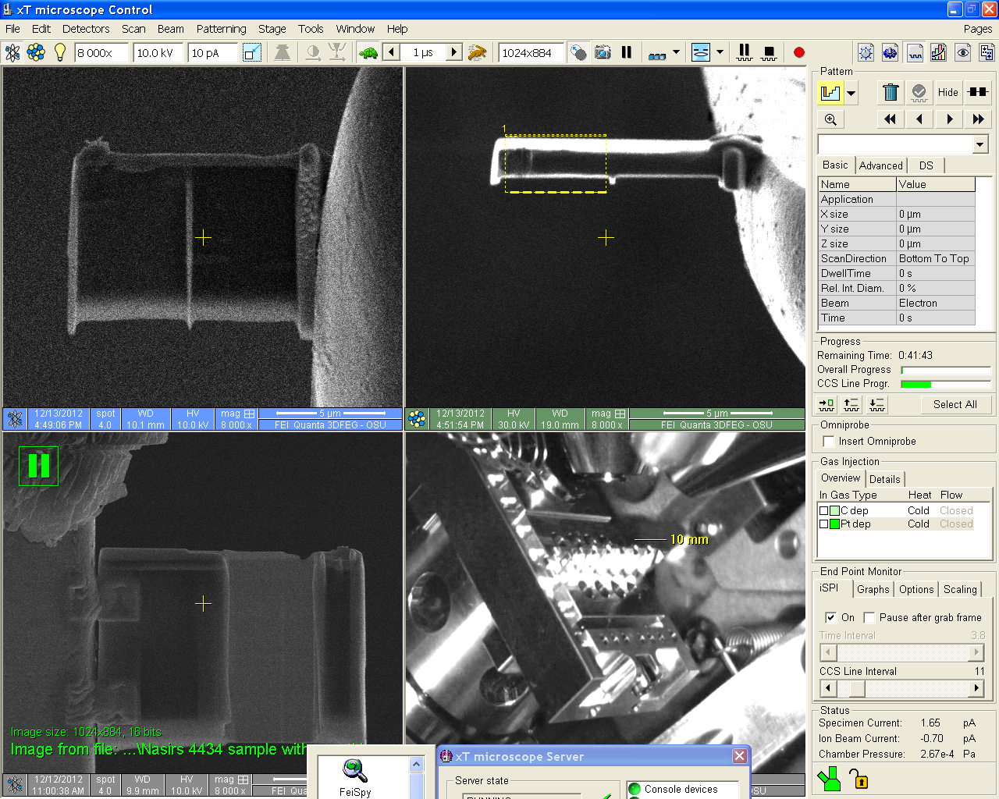
Backside thinning. At 50.8 degrees or minus 1.2 degrees from normal
The backside of the sample has a lot of damage as this is where ion frames of high current were grabbed. We grabbed these high current ion images when we did the J cut. So the majority of the thinning should occur on the backside!
Change pattern from top to bottom

Slide 40
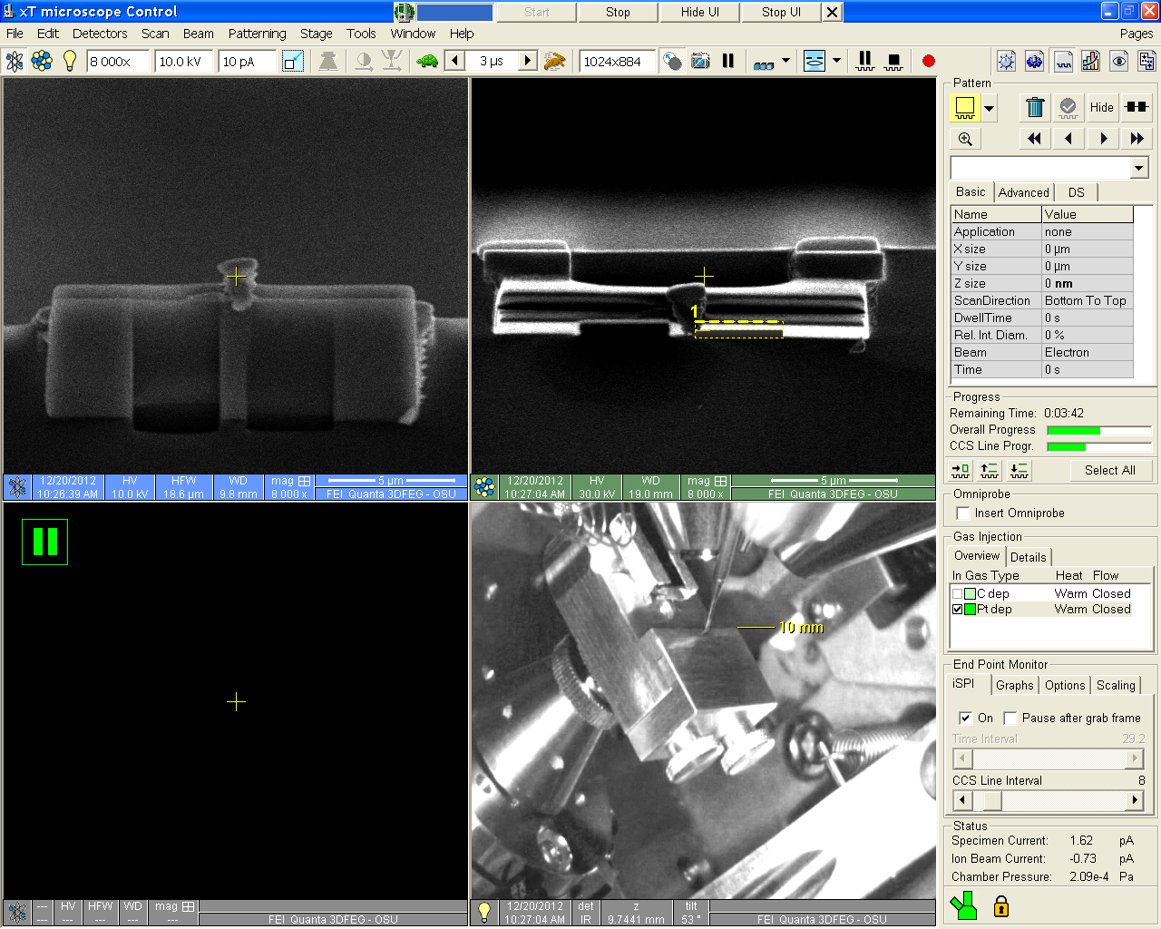
Frontside thinning on a Silicon grid
Grid edge!
53.2 degrees

Slide 41
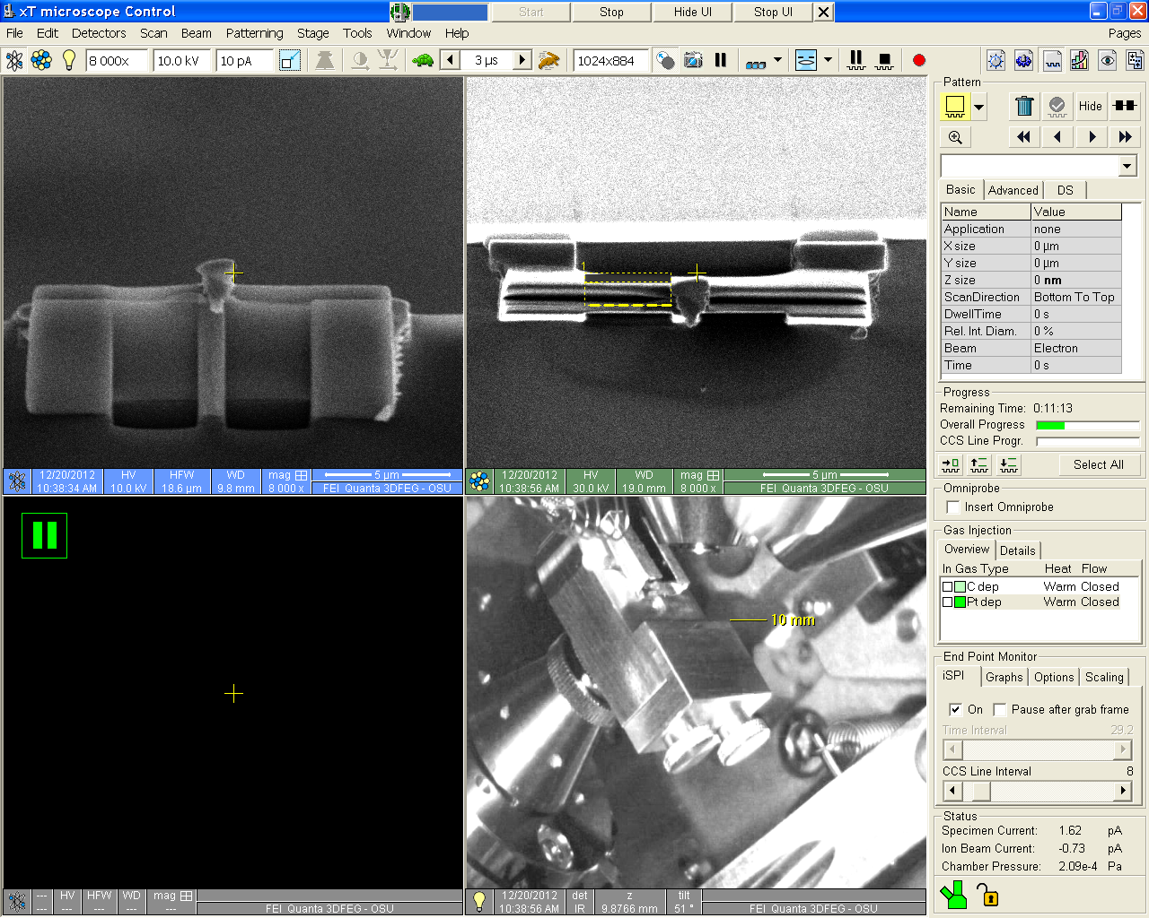
Backside thinning on a Silicon TEM grid
Note, we thin between welds so as not to destroy welds At 50.8 degrees
Is the backside of the sample ever visible in the electron view?

Slide 42
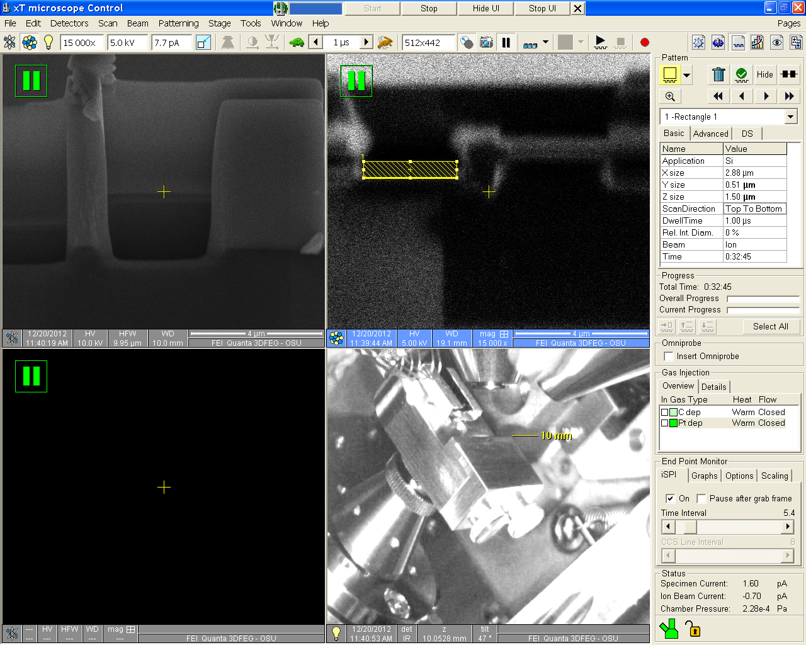
5 kV backside polish
face
Notice 5 kV and 7.7 pA current. Let it polish for 15-20 seconds. Up to 30 seconds will help, if you are confident you are not over the top of your sample – you are sure you are not thinning it.
Rectangle over the backside face avoid sample top!!
Monitor in iSPI!!!
We never fully get rid of Gallium implant. We minimize it by replacing the 30 nm of implant depth at 30 kV with 2-3 nm of implant depth that occurs at the 5kV polish.

Slide 43
Appendix
Checking Omniprobe alignment

Slide 44
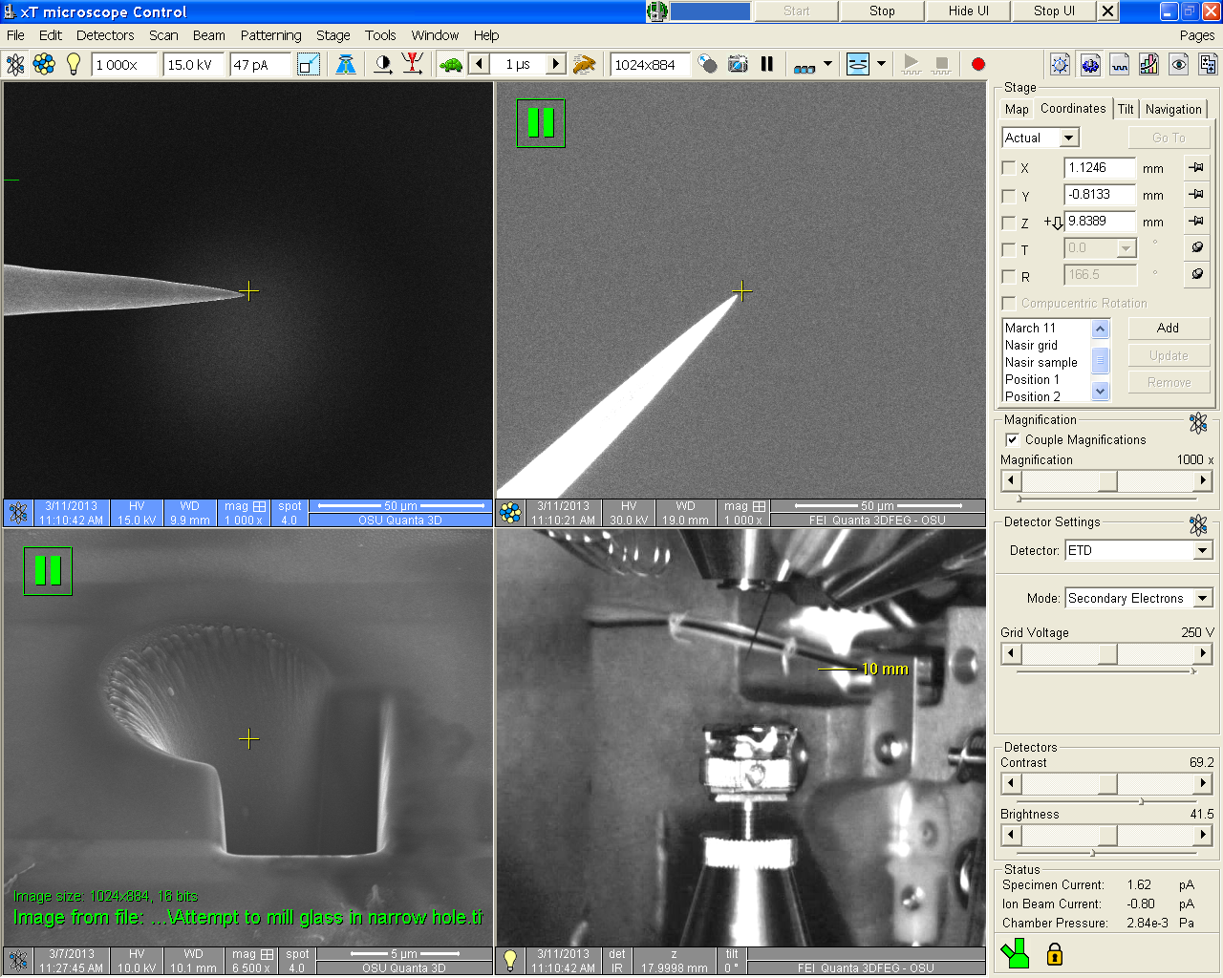
3) Check to make sure needle is in center of ion frame, if not you will have to adjust y then z to get to center. You will then have to go back to step 2 and refocus.
2) Get needle to center and check focus height, should be 10 mm plus or minus .2 mm; this is Eucentric Height or Impact Zone!
Steps 3 and 4 repeated till no change.
1) Drop Stage!

Slide 45
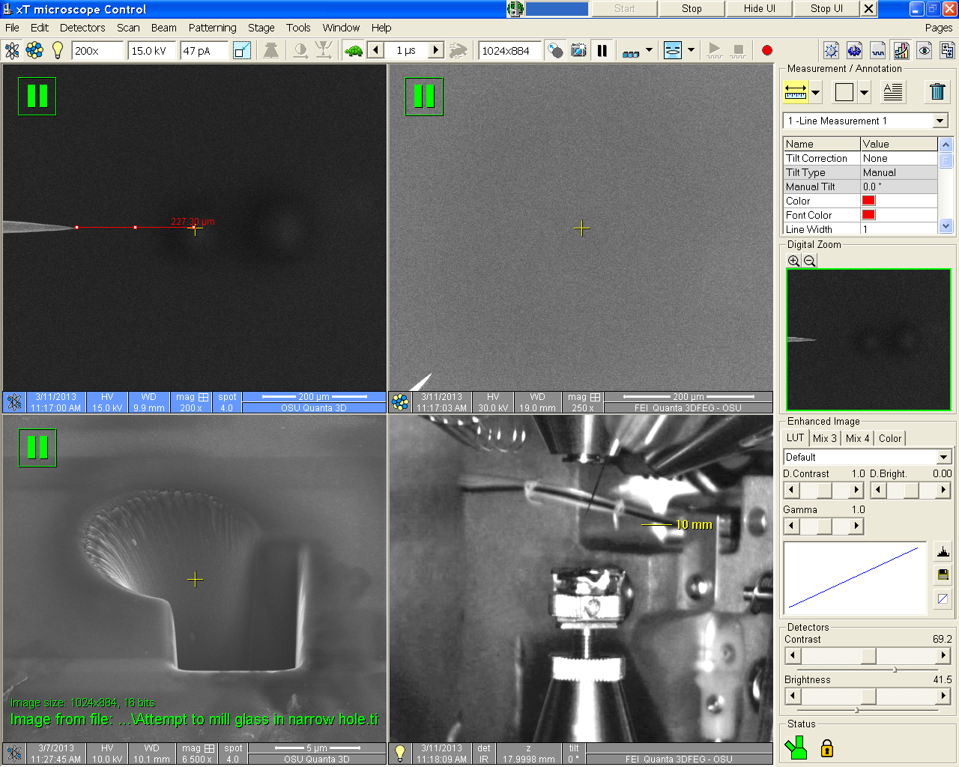
Now retract needle when it is at Eucentric plus 200 microns. At this distance the needle will always appear in lower left of lowest possible mag. ion frame

