Slide 1
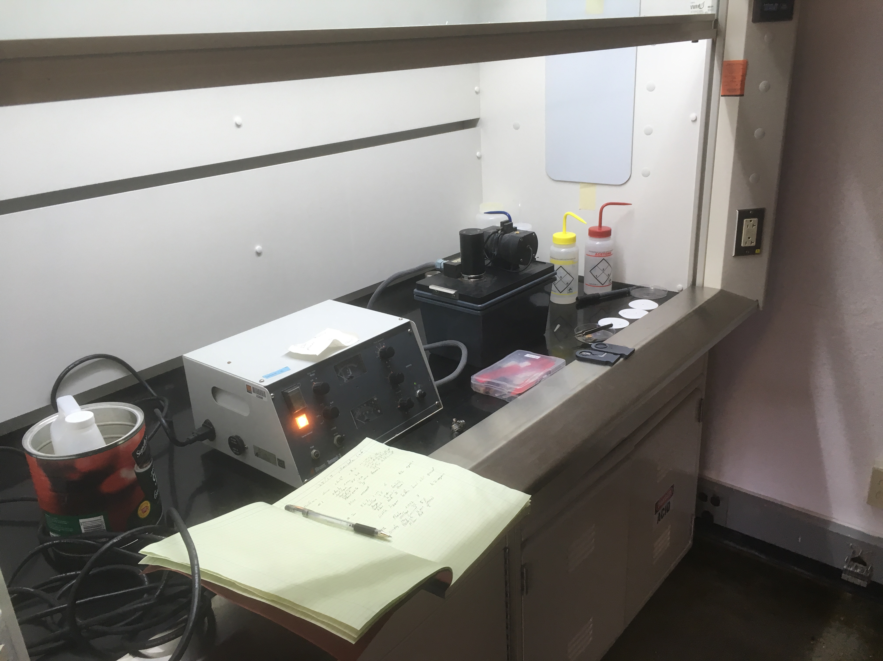
Using The Struers Tenupol 3 Twin Jet polisher in the Santala Lab.

Slide 2
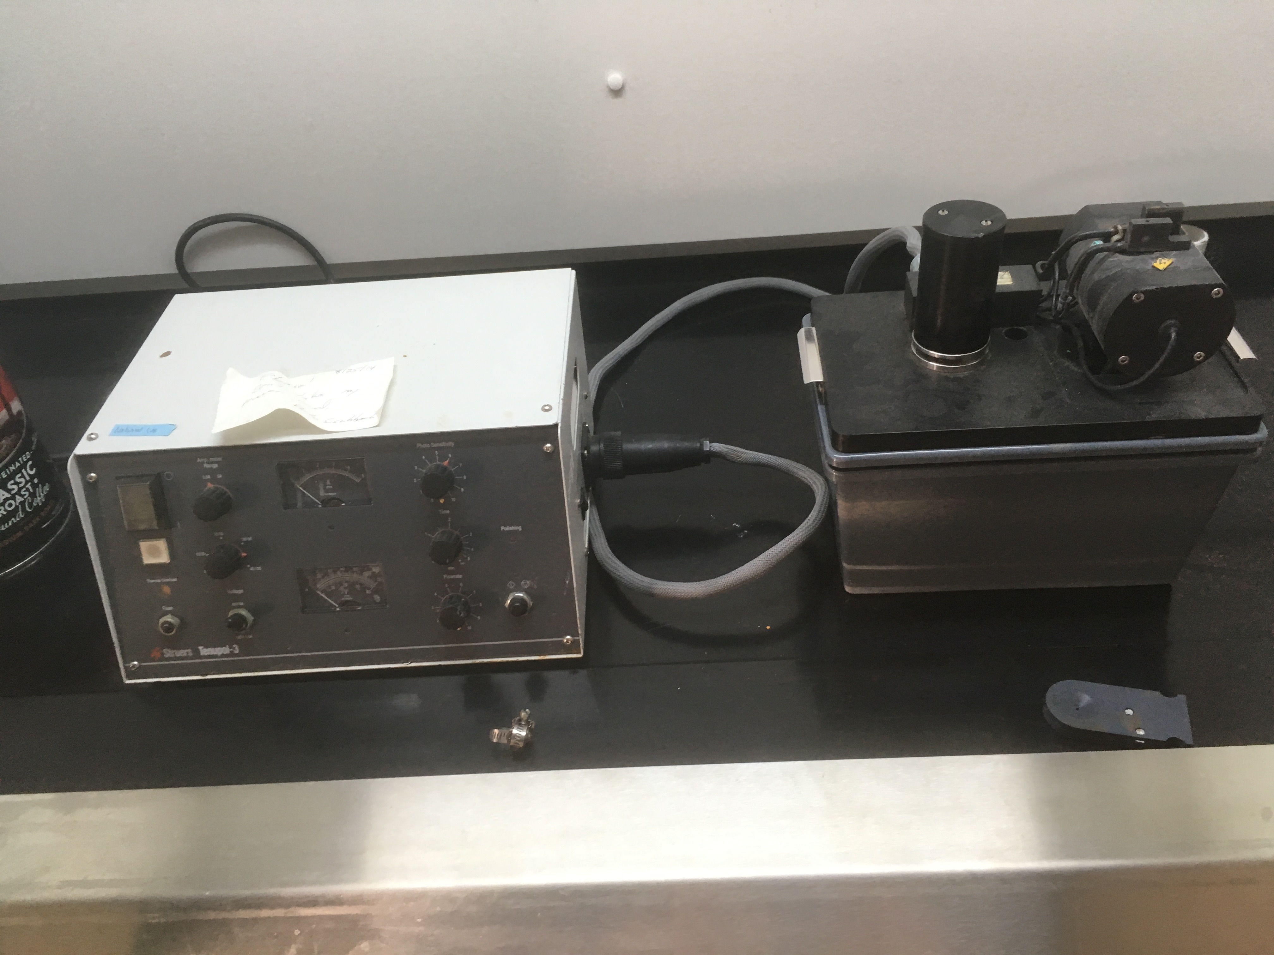
Twin Jet Polisher* in the Santala lab.
*A twin jet polisher is probably the fastest way to prepare metallurgical samples. You simply need to cut a thin slice on diamond saw. Polish to .5 mm thickness and punch out a 3 mm disk . Polish jigs and 3 mm punch are available in the OSU EM facility if needed. Pete Eschbach can assist you with mounting and cutting on diamond saw, polishing to .5 mm thickness and punching your 3 mm washer. And Pete can help with the twin jet polisher as it is a joy to behold!
Struers Tenupol 3. on semi permanent loan from DOE NETL

Slide 3
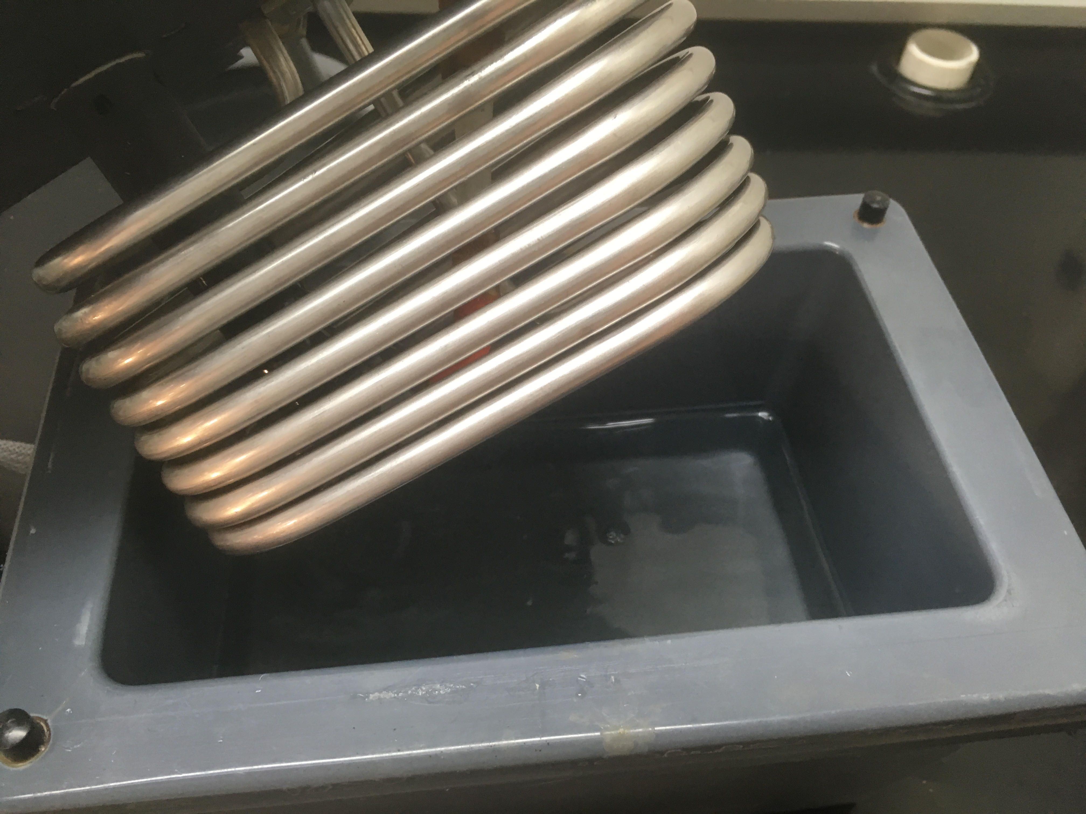
Add your etchant. This is recipe A2: 70% ethanol, 10% perchloric acid, 10% ButoxylEthanol, and 10% DI water. Use proper PPE and splash resistant glasses!

Slide 4
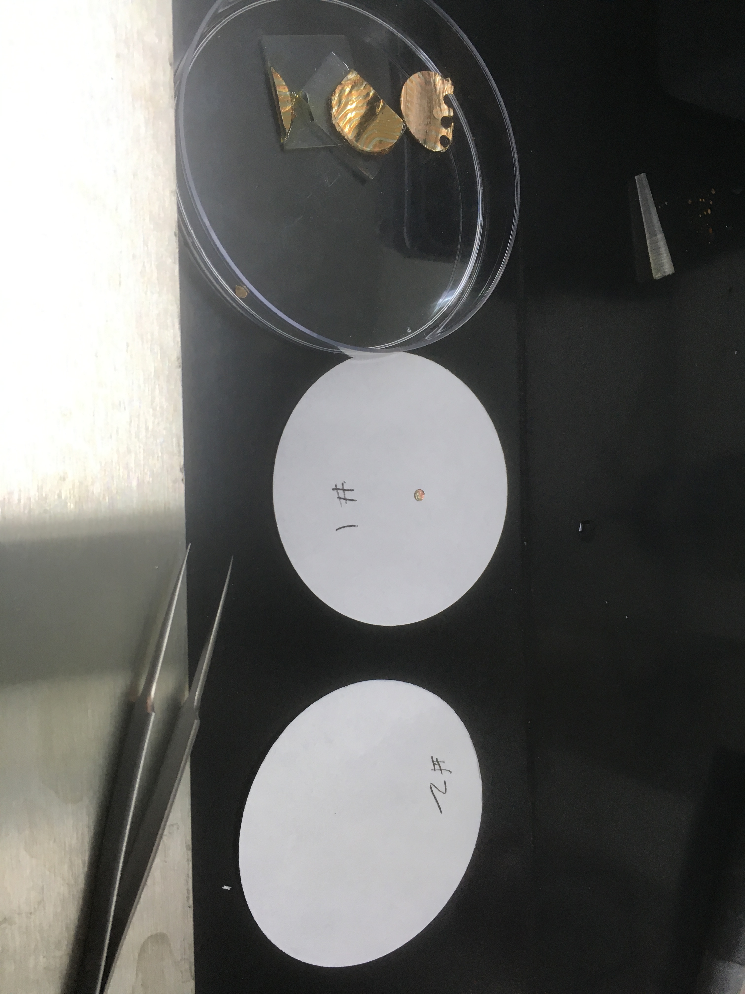
Get yourself a good work area and some filter paper to collect samples.

Slide 5
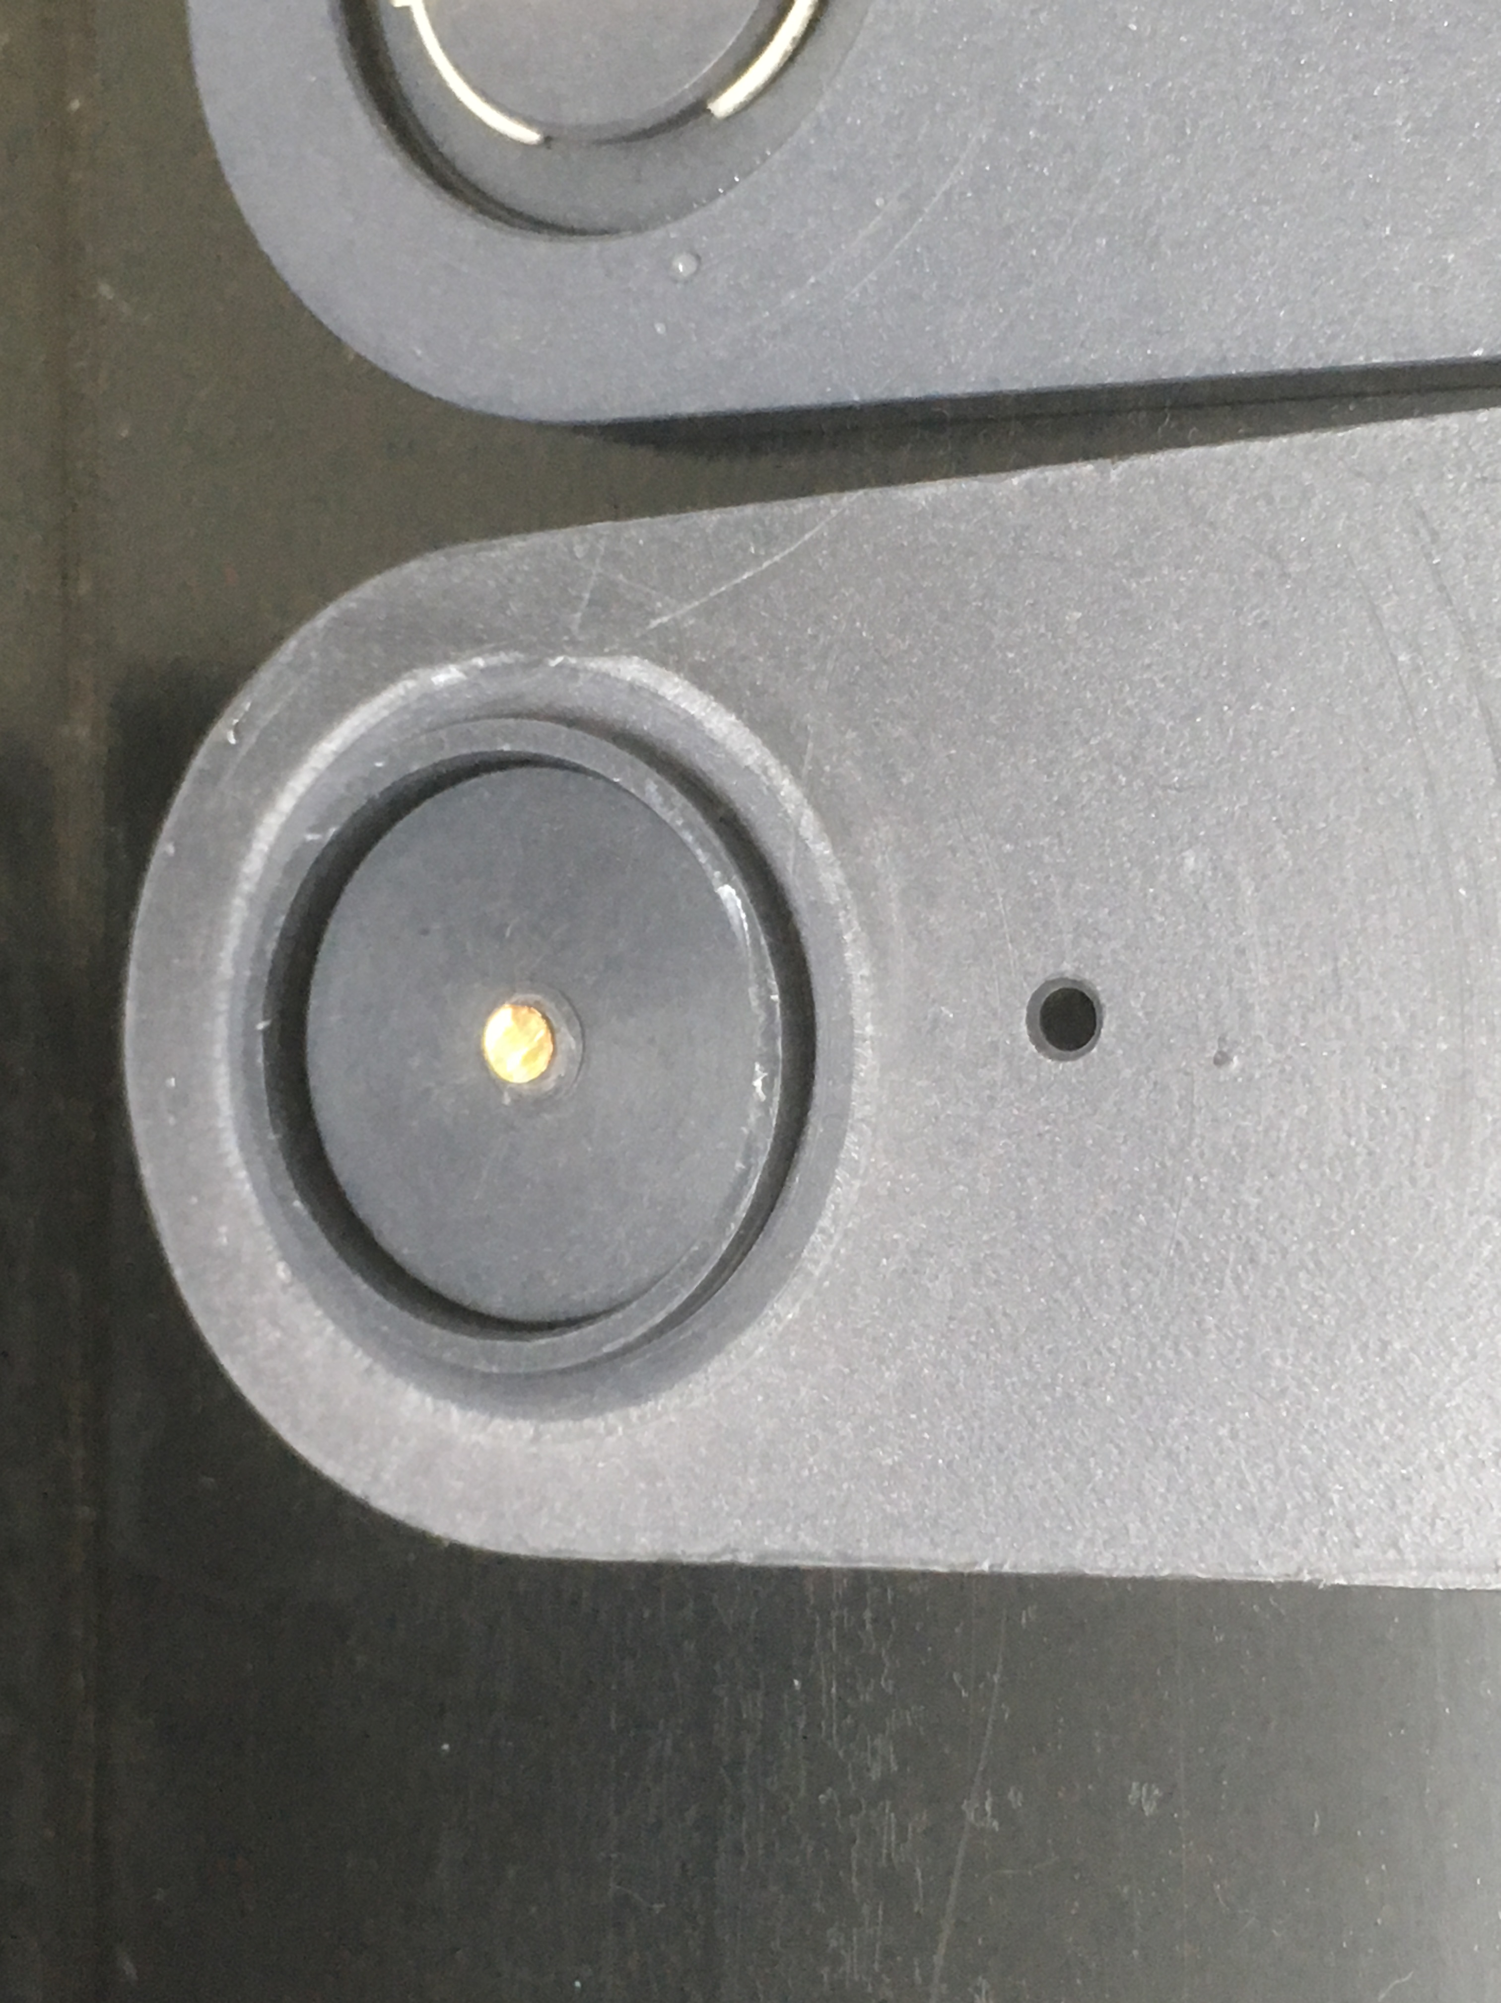
Load your 3 mm diameter foil

Slide 6
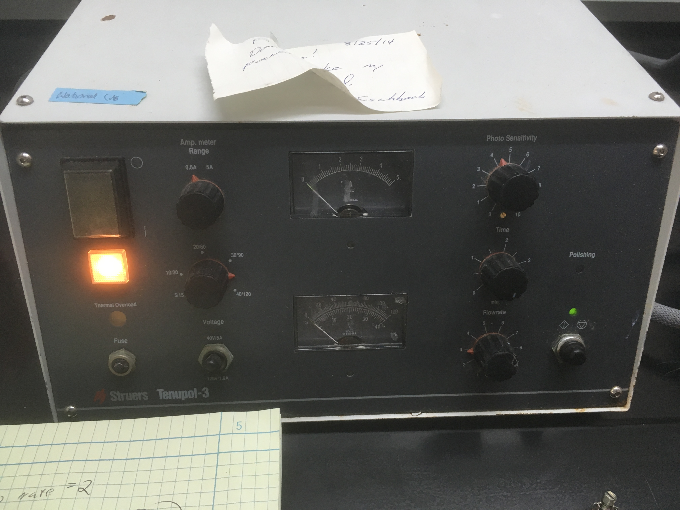
Set the parameters for milling. A good starting point at room temperature is: Photosensitivity 8, Voltage 35, current display .5 nA, polish of 2 minutes and flow rate 3
More photo sensitivity corresponds to thinner samples.
The setting here, 4, is too aggressive at room temperature and will obliterate your foil! Try 8 to start off and work down to 6 if need be.

Slide 7
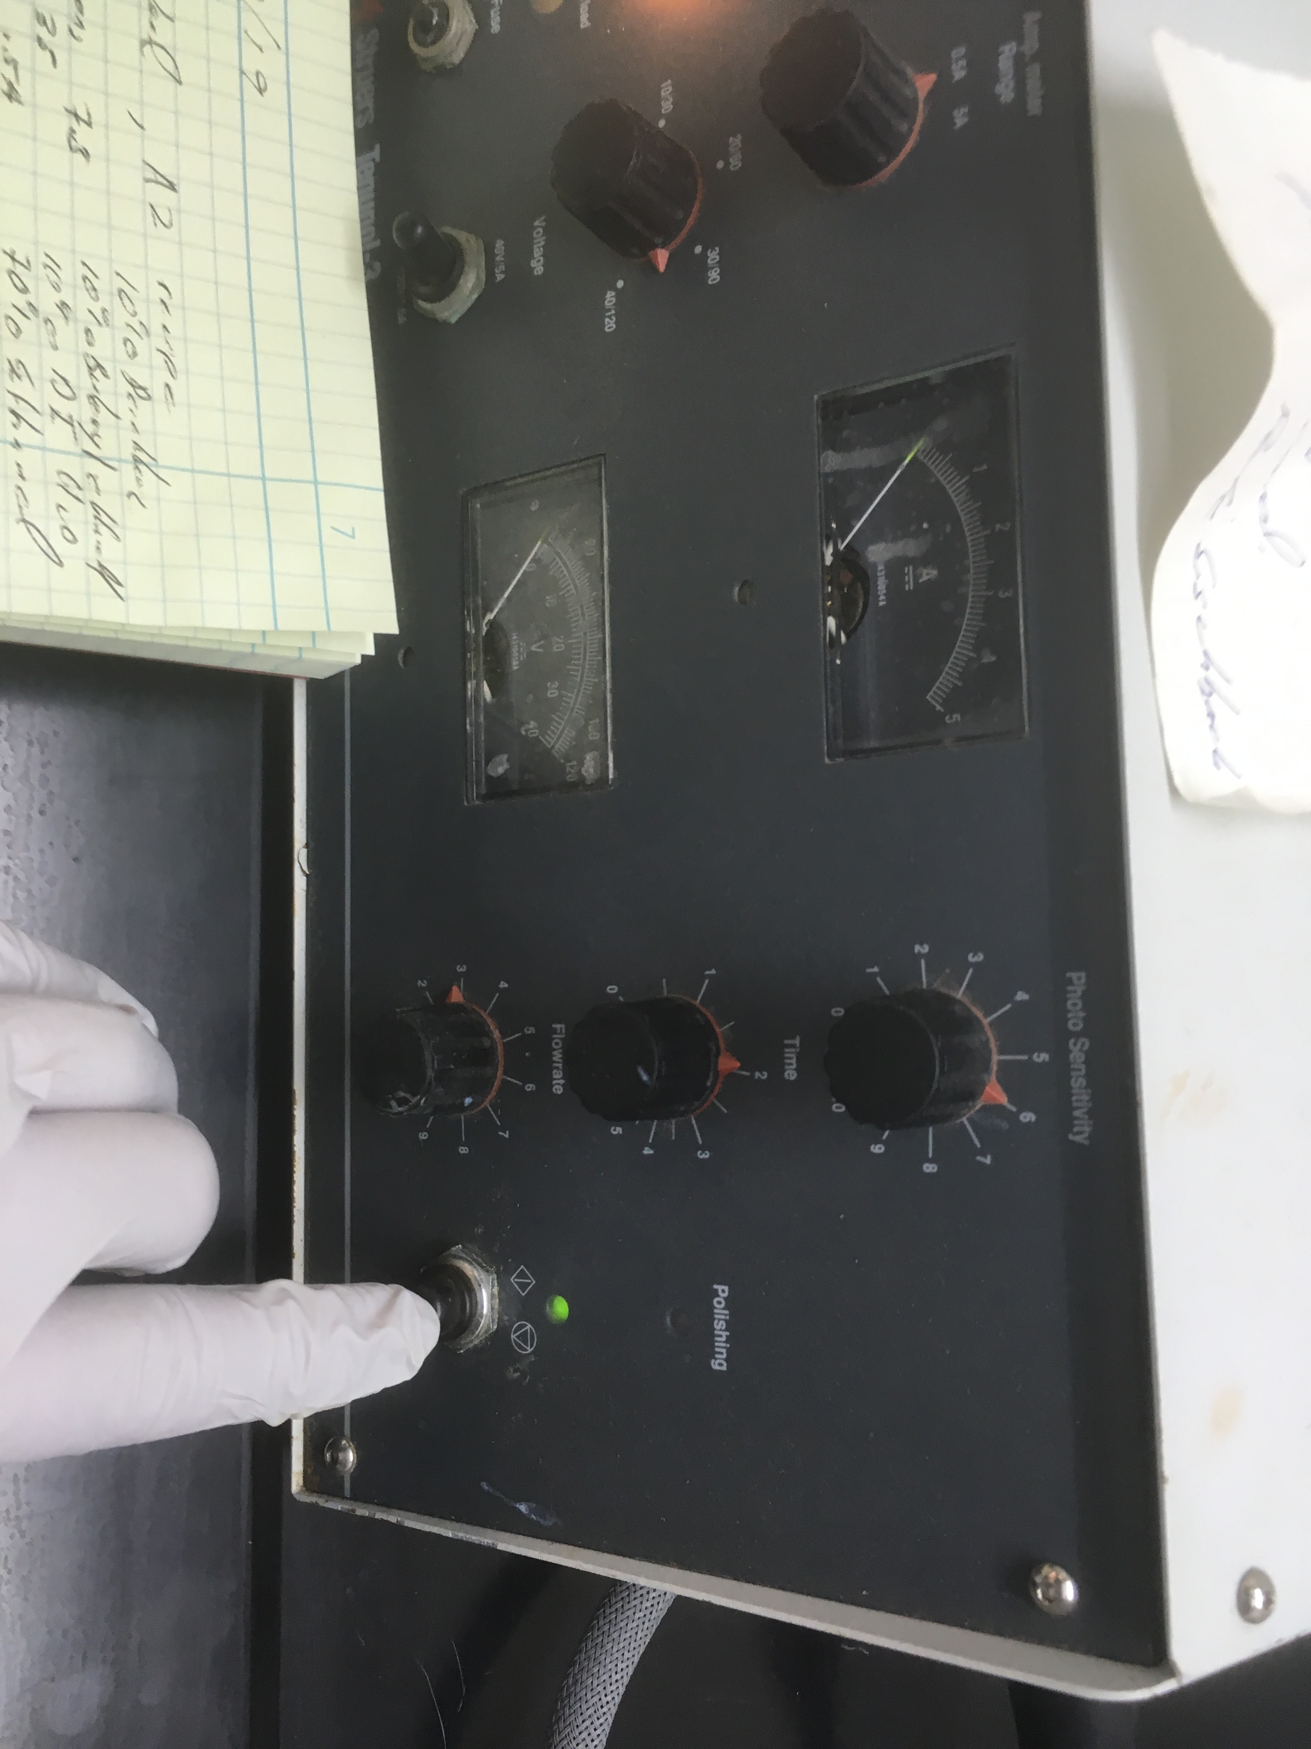
Now push the mill button. It will turn red and you will hear the jet pumps start. Eventually you will see the etch current, nominally .4 amperes.

Slide 8
When the IR photo sensor detects that it is done, a hole has been generated, the twin jet stops and the light turns green.

Slide 9
Save your solution in a marked container and with secondary containment.
Marked container!
Put in secondary containment if you are transporting it.

Slide 10
When done run water through the system. This will require that you put a dummy foil in so that conductivity is sensed and jets turn on.

