Slide 1
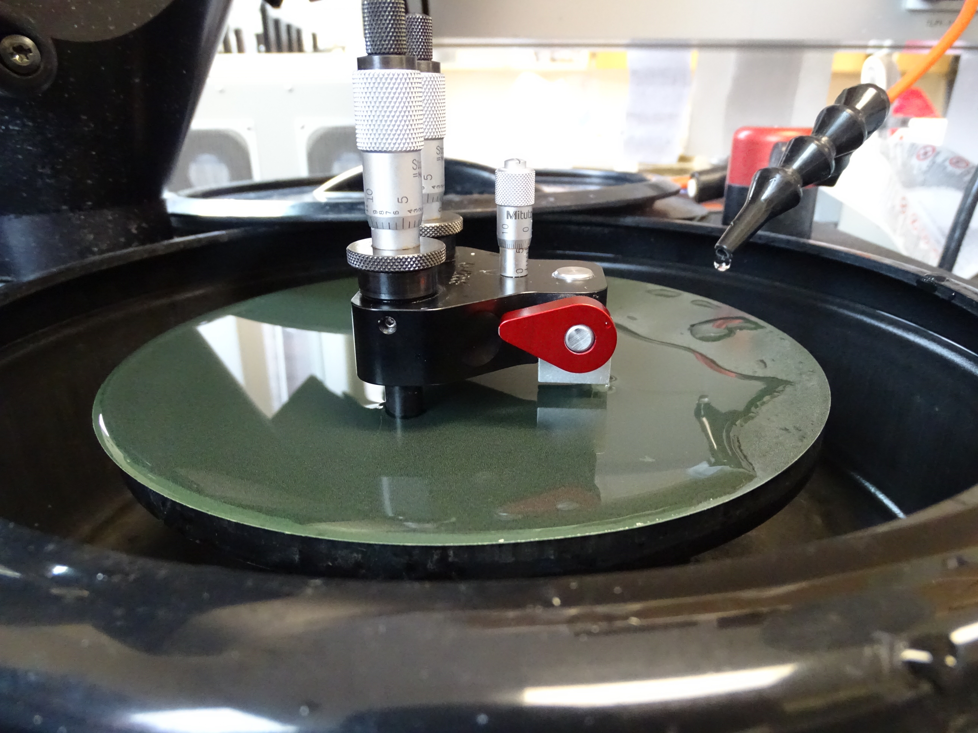
How to make a low cost* TEM wedge sample with grinder polisher
* This is a much lower cost alternative to a Million Dollar FIB prep. It is a technology you can take with you anywhere in the world. You only need a grinder polisher $4000, $1000 diamond saw, and a $1500 tripod polisher and access to a good low power stereo microscope. And roughly $200 worth of diamond lapping films.
Peter Eschbach
Oregon State University

Slide 2
Protect glass cover slip is applied to your die or metal foil with 110 adhesive
Glass cover slip with 110 adhesive, Mbond works well also
sample

Slide 3
Put on hot plate at prescribed temperature and squeeze sample to cover glass with “alligator clip.”

Slide 4
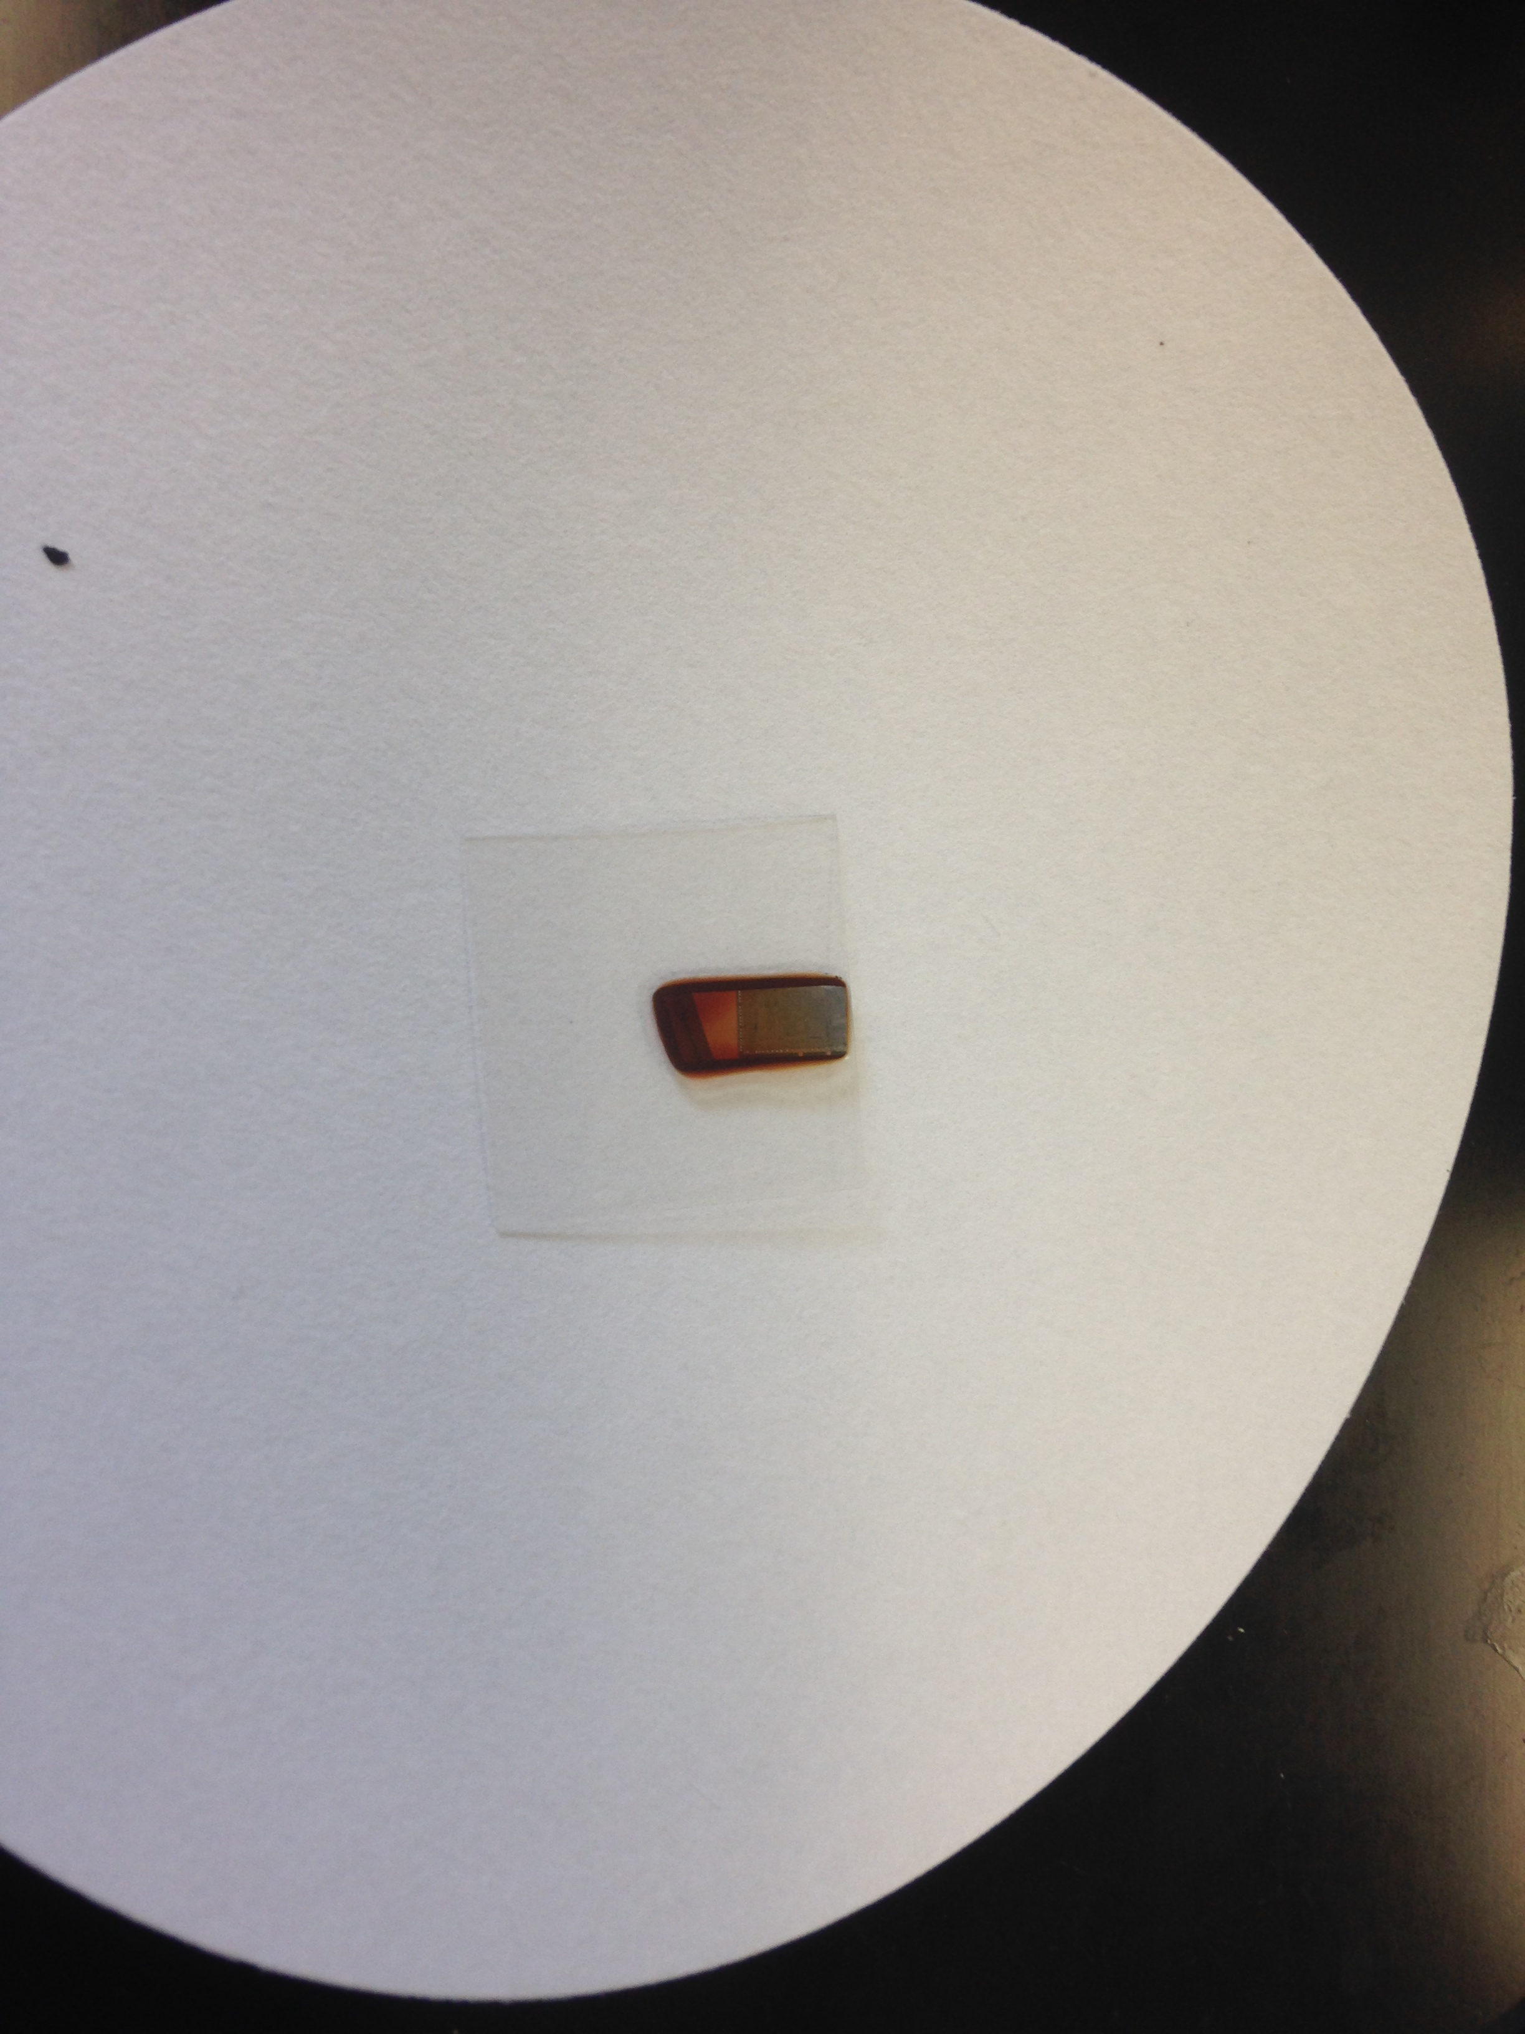
Protect glass is now bonded as indicated by amber color of adhesive.

Slide 5
There are two options for ground samples, cross section and plan view. This is plan view and it has no cover slip, no protect glass. First we will do Cross section
Sample to be thinned plan view
Cross sectioning paddle

Slide 6
Sample prep method 1, cross sectional
Cross sectional is a bit more complicated
We first mount sample parallel to long axis of cross sectioning paddle and then grind and polish to the area of interest (AOI).
Then we remount the sample perpendicular with AOI down.
With AOI down we thin to a wedge for electron transparency

Slide 7
Cross sectional sample prep Overview
Area of interest. For example a defect in metal
Step 1 protect layer
Glued on
Protect glass
sample
Thin adhesive bond line(s)
Step 2: mount long axis // to cross section paddle and grind to area of interest
Optional second protect glass
For sensitive samples a second protect glass is added to bottom
2
Grind and polish to area of interest (AOI)
2
Less than 3 mm
3
Step 3 sample de-bonded and rotated to thin to AOI
AOI down!
Towards glue
In step 3 we have unglued and re-bonded to thin a wedge to area of interest
3
AOI

Slide 8
Work must be done on diamond saw to trim piece
Trim your piece on high speed diamond saw

Slide 9
Here we are slicing a thin slice of Nickel steel so we can then planarize it on grinder.

Slide 10
Planarizing Nickel Steel sample
Fischione model 160 planarizing jig
Sample
This area captures sample for holding it!

Slide 11
Now, we can hold onto the sample and decrease thickness with knob as we grind!

Slide 12
Now that sample is planarized, metal samples typically don’t come planar, Silicon does
We must trim it on diamond saw to maximum dimension 3 mm so that we can glue it to a 3 mm TEM grid. No standard TEM anywhere in world takes a sample bigger than 3 mm.
Then we mount it with hot melt, actually tree resin
Then we can thin it to rough electron transparency with the tripod polisher tool and diamond lap films (DLF) in LPSC room 145.
Finally, PIPS, precision ion polishing (PIPS) in Melissa Santala’s lab in Dearborn.

Slide 13
Our planzarized Nickel metal foil now being trimmed to 3 mm max dimension

Slide 14
Here we are trimming an integrated circuit so that maximum dimensions are 3 mm, so it can be thinned and glued to a 3 mm TEM grid.

Slide 15
Level the tripod polisher and grind the Delrin feet to planarize. Per the instructions in the Allied High Tech Tripod polisher in LPSC room 145.

Slide 16
Slight angle on tripod polisher so that a wedge is made
Start with 30 micron DLF
Then 15 um
6 um, 3um, 1/2 um
And final polish at .05 micron Silica or Alumina
At start
At end
We thin through glass and leave just region of interest!

Slide 17
Once we have thinned it to rough electron transparency, 150-300 nm we mount it on a grid. This is the hardest part.
Float the sample from the hot melt resin by soaking in acetone in a small beaker with filter paper at bottom
Collect sample in filter paper
Then put small drop of 110 or M bond adhesive on TEM grid of your choice, author believes Slotted grid with tab is easiest, see next slide.
Drop grid wetted with drop of epoxy onto sample on filter paper, do not attempt to pick up sample up with tweezer. It is very fragile!

Slide 18
Sample pick up onto slotted grid
Glue slotted grid to glass slide with Loctite removable adhesive or hot wax.
Put dab of 110 adhesive on slotted grid.
Lower slotted grid with glue side down onto the thinned sample.
Put slotted grid and glass slide on hot plate to cure 110 adhesive
Cut tab off slotted grid to and place grid in TEM grid box for analysis!

Slide 19
Mounting the wedge sample to TEM grid, higher Mag image
This Si sample was still attached to the glass protect layer. To make a viable sample, it would have to have been separated from the glass backing then glued to the slotted grid.

Slide 20
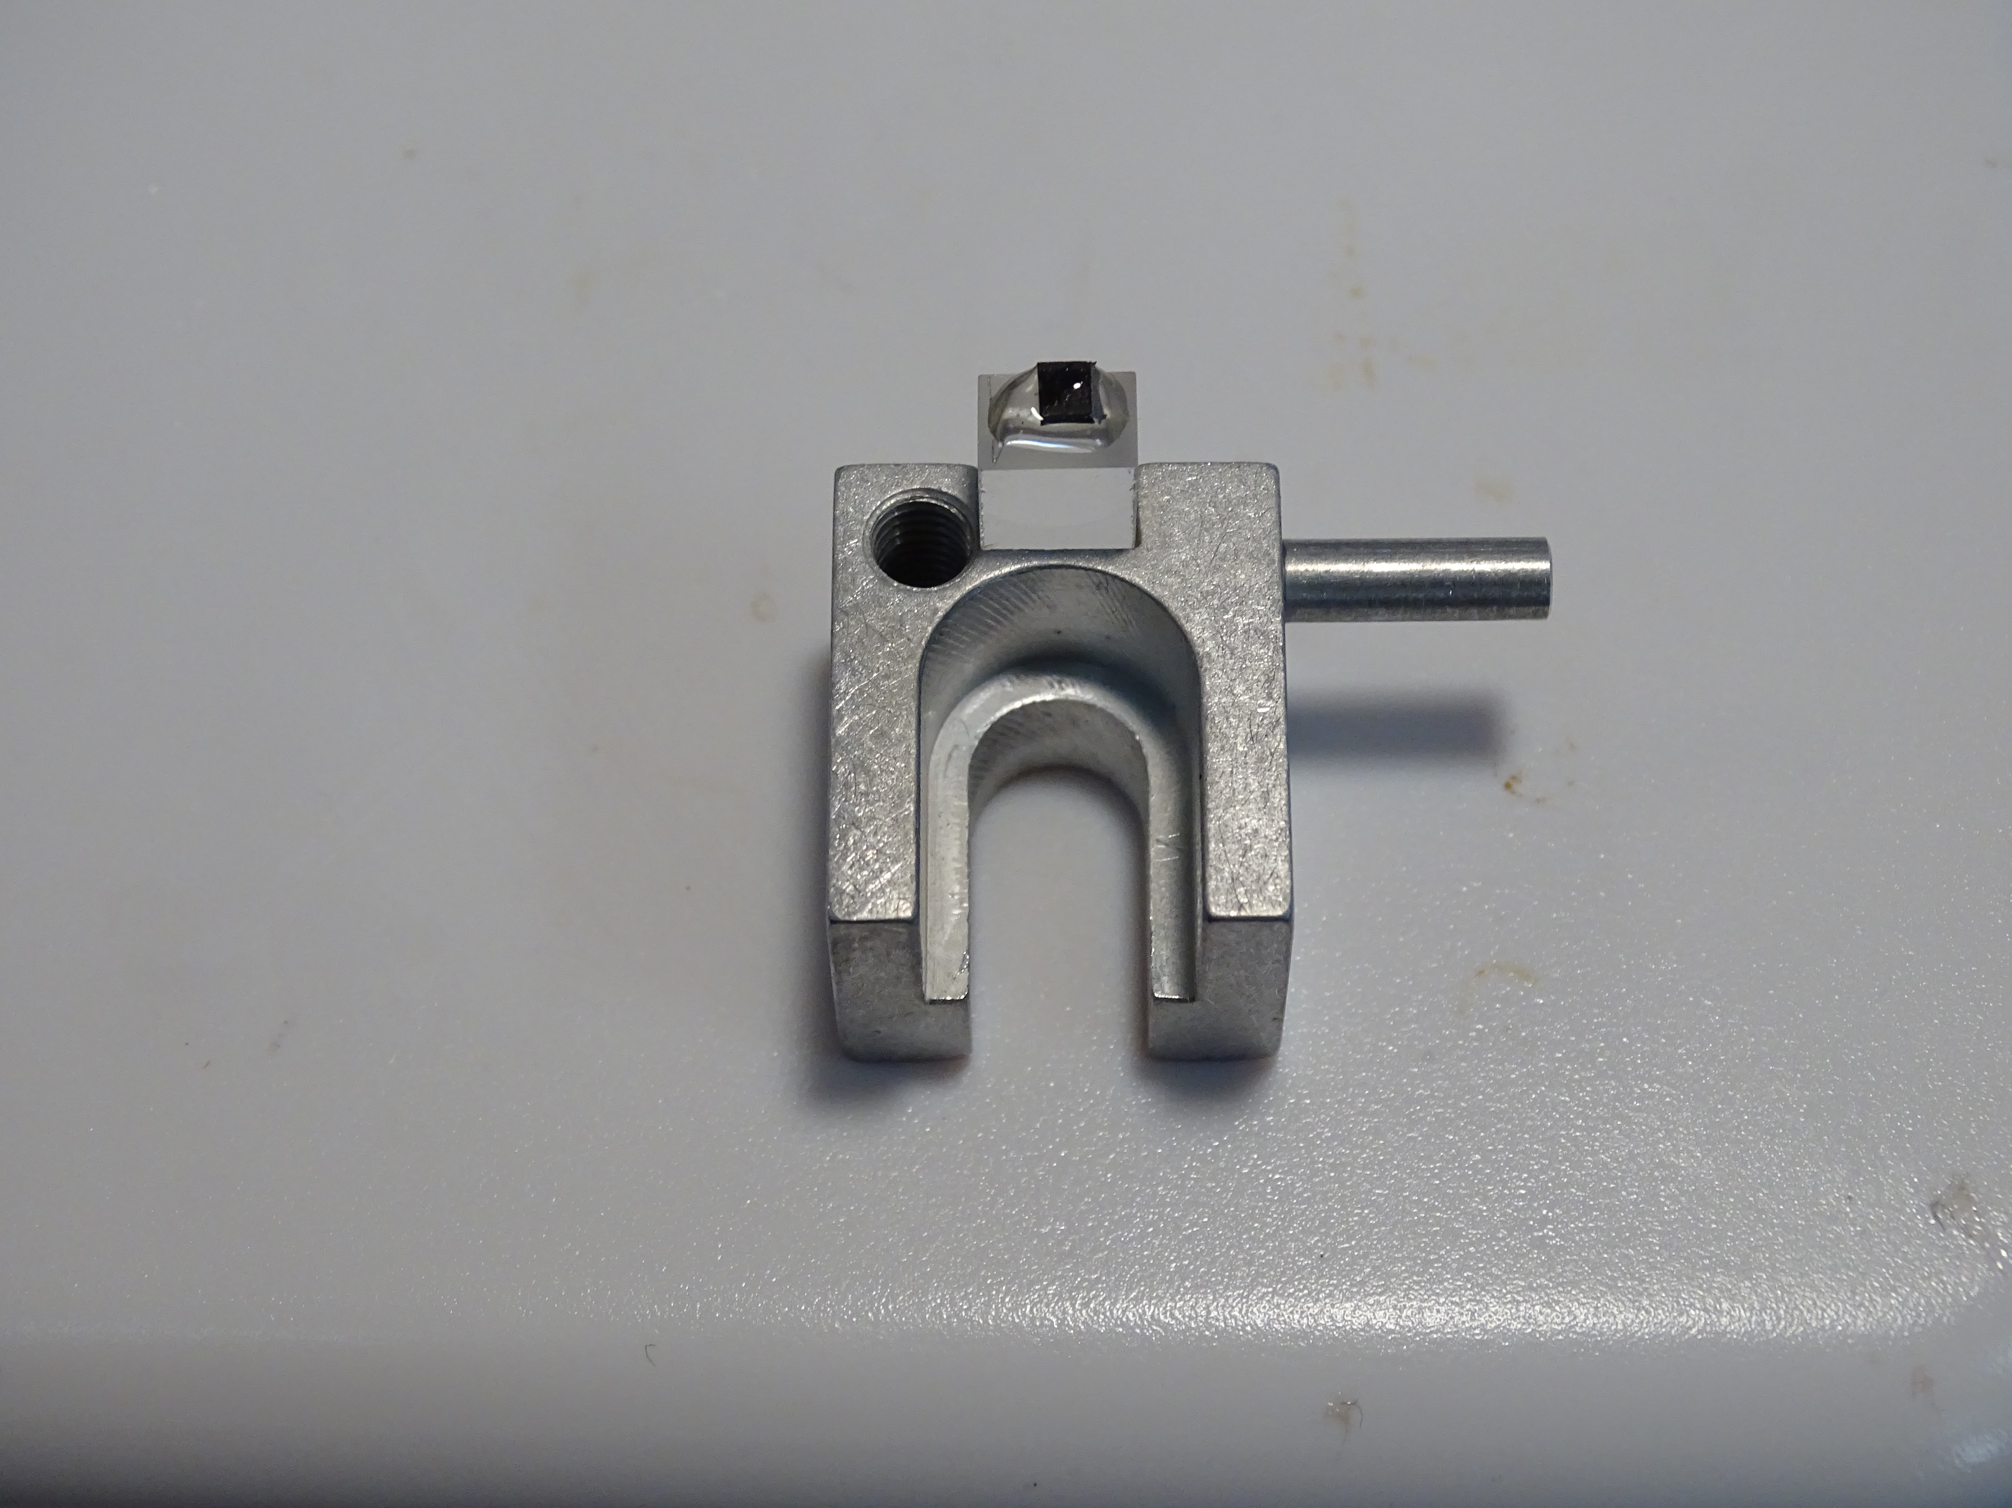
Plan view sectioning, method 2
Sample is mounted just to the edge

Slide 21
Switch to 15 um Diamond lap film

Slide 22
Thinned about half way.

Slide 23
Then switch to 3 um Diamond Lap Film
Silicon sample is quite thin and barely visible

Slide 24
Now switch to ½ um DLF and then final polish with .05 micron Silica
Amber color of Si indicates electron transparent, and you can see electronic interconnects. Sample is ready to be debonded and transferred to a TEM grid

Slide 25
Once electron transparent wedge has been formed, time to transfer it to a TEM grid
Follow same procedure detailed in slides 17, 18
Keep in mind that the thin side of sample should be in middle of grid when you glue it for maximum viewing potential at tilt.

